Slide 1

Welcome
Global health
Session 5
Dr. Tilly Paz

Slide 2

In this session you will:
Review the costs and consequences of communicable diseases of importance
Outline some of the most important examples of successful interventions against communicable diseases
Discuss key challenges to the future prevention and control of these diseases

Slide 3
Key terms and concepts

Slide 4
The Importance of Communicable Diseases
Cause 40% of deaths and 40% of DALYs in low- and middle-income countries
In small groups, use your time to answer one of these questions around the importance of CD, with examples that you will then present to the class
Disproportionately affect the poor – Why?
Enormous economic consequences – Examples?
Relevance to SDGs – How?
Much of the burden of communicable diseases is avoidable, many can be prevented or treated – How?

Slide 5
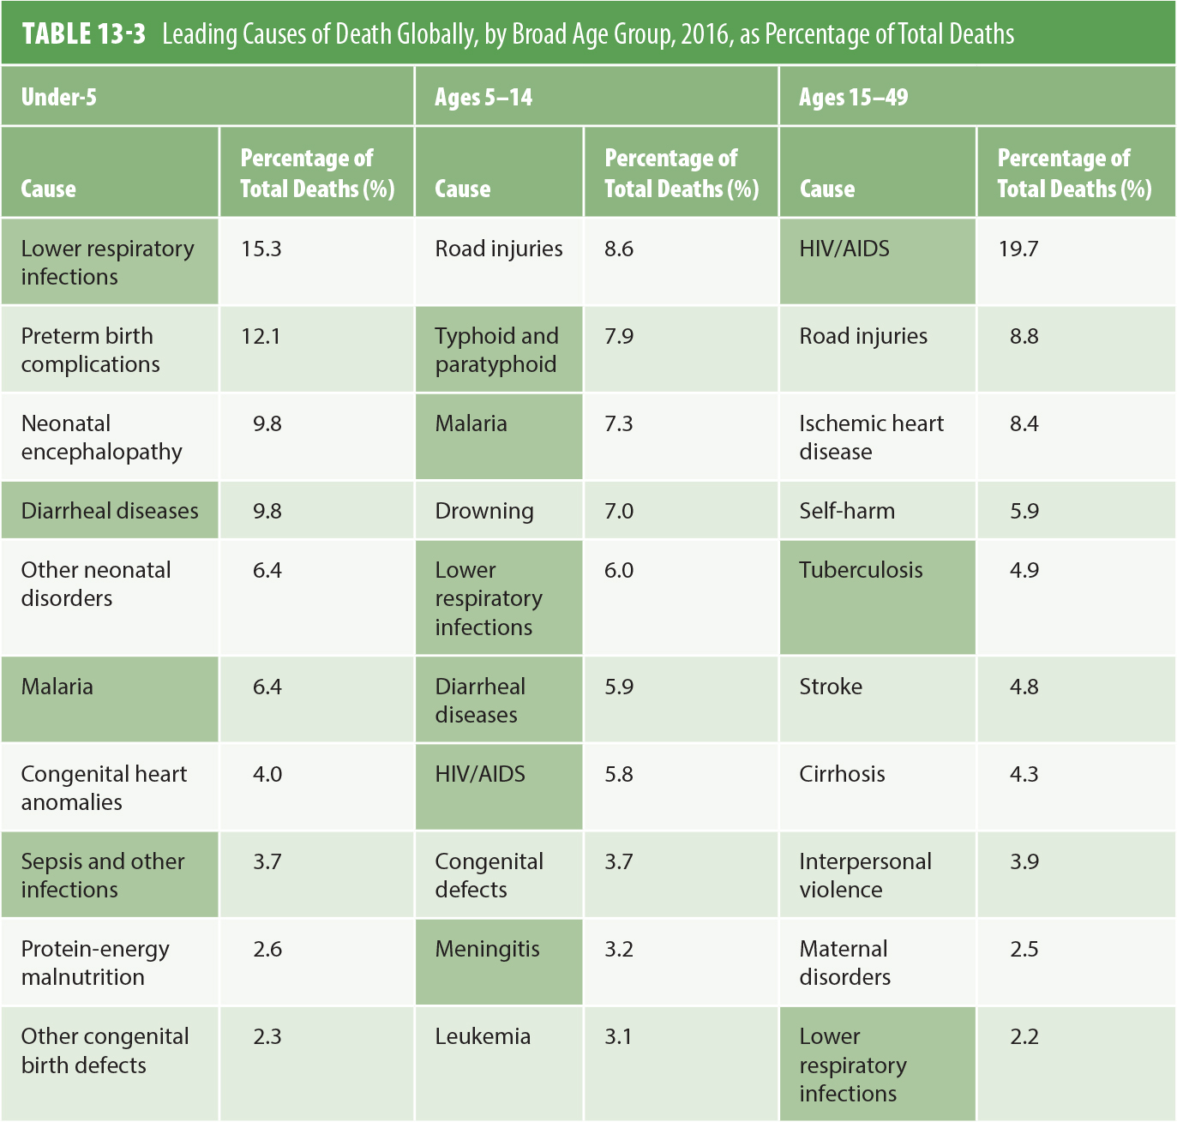
The Burden of Communicable Diseases
Data from Institute for Health Metrics and Evaluation (IHME). (n.d.). GBD Compare: Viz Hub. Retrieved from https://vizhub.healthdata.org/gbd-compare/

Slide 6
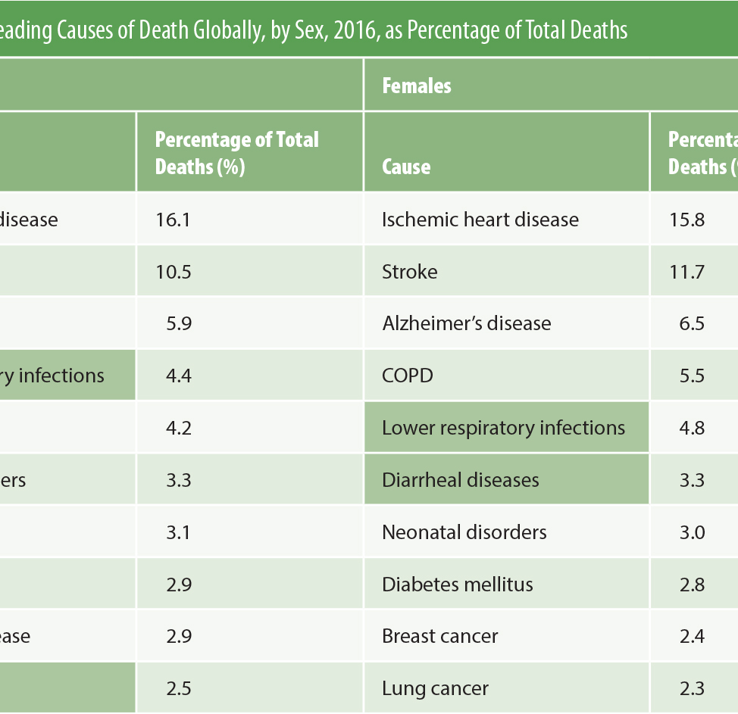
The Burden of Communicable Diseases
Data from Institute for Health Metrics and Evaluation (IHME). (n.d.). GBD Compare: Viz Hub. Retrieved from https://vizhub.healthdata.org/gbd-compare/

Slide 7
The Costs and Consequences of Communicable Diseases
Constrain health and development of children, affecting schooling and adult productivity
Strong stigma and discrimination associated with HIV, TB, and others such as leprosy
Limit productivity and income of adult workers
Costs of treatment burdens families (especially where there is no funded healthcare)
High rates of communicable diseases reduce investment in a country’s development

Slide 8
The Leading Burdens of Communicable Diseases
The Burden of Emerging and Reemerging Infectious Diseases
Truly global threats and “a perpetual challenge”
Zoonoses (infection spread from animals to humans) cause of about 60%
Key factors include microbial adaptation and change, climate, changing ecosystems, international travel and commerce, and war

Slide 9
The Leading Burdens of Communicable Diseases
Antimicrobial Resistance
Resistant forms of disease can emerge or reemerge when bacteria, parasites, and viruses are altered through mutation, natural selection, or the exchange of genetic material among strains and species

Slide 10
The Leading Burdens of Communicable Diseases
Antimicrobial Resistance
In 2017, about 558,000 people globally developed multidrug-resistant TB
There is resistance to all malaria drugs
Factors contributing to development of drug resistance include increasing use of drugs, poor prescribing and dispensing practices, inappropriate use, failure of patients to take correct dosages, and counterfeit drugs

Slide 11
The Leading Burdens of Communicable Diseases
Addressing Antimicrobial Resistance
Improved surveillance and laboratory capacity
Uninterrupted access to essential medicines of assured quality
The regulation of medicines, including in animal husbandry
Improved infection control
Innovation

Slide 12
The Leading Burdens of Communicable Diseases
The Consequences of Emerging and Reemerging Infectious Diseases
Substantial direct and indirect costs, that are not proportional to deaths from these events
Drug resistance costs are also very high
Treating a case of drug-resistant TB has been estimated to be about 175 times the cost of treating a case with first-line drugs

Slide 13
The Leading Burdens of Communicable Diseases
Addressing Emerging and Reemerging Infectious Diseases
Sensitive surveillance systems and public health laboratories
Global collaboration and willingness to share information with other countries
Rapid detection of new outbreaks
Mechanisms for effective containment

Slide 14
The Leading Burdens of Communicable Diseases
Addressing Emerging and Reemerging Infectious Diseases
GOARN-a network of existing disease surveillance networks established in 2000
Global network participants include United Nations agencies, the International Federation of the Red Cross and Red Crescent Societies, and Doctors Without Borders

Slide 15
The Leading Burdens of Communicable Diseases
Future Challenges
AMR, Emerging and Reemerging Infections
Rapidly evolving pathogens, population growth, climate change will increase number of emerging diseases
Possibility of a major pandemic
Accelerating drug resistance
Limited number of anti-infective drugs being developed

Slide 16
CDs Posters
In your group, use the information provided to create a full-size poster
Next to the poster, hang a page with 5 questions that the poster answers. Choose the main issues that you wish people understand from the poster
Others will walk around the room, answer the questions, and then we will share in the class

Slide 17
HIV/AIDS
The Burden of HIV/AIDS (2017)
Number of people living with HIV/AIDS: 36.9 million (look for the newest data)
Prevalence among adults aged 15–49: 0.8%
Number of new HIV infections: 1.8 million
Number of HIV-related deaths: 940,000
Proportion of all adults living with HIV receiving ART: 59%
https://ourworldindata.org/hiv-aids

Slide 18
HIV/AIDS
The Burden of HIV/AIDS
When HIV first appeared in a population, it initially concentrated in sex workers, men who have sex with men, or injection drug users
Highest prevalence rate of HIV/AIDS is sub-Saharan Africa: 4.7% of the adults aged 15–49
In sub-Saharan Africa, women are twice as likely as men to be living with HIV

Slide 19
HIV/AIDS
HIV Treatment
The global community has made a commitment to trying to ensure that all people with HIV are placed on treatment when diagnosed
UNAIDS estimated that in 2017, 75 % of HIV-positive people knew their status and 79% of them were on anti-retroviral therapy

Slide 20
HIV/AIDS
The Costs and Consequences of HIV/AIDS
Enormous impacts in high prevalence countries that go beyond morbidity and mortality, including:
Agricultural production
Education systems
National security
Public services
Creates exceptional number of orphans
Highly stigmatized condition
Difficult for high-prevalence, low-income countries to finance

Slide 21
HIV/AIDS
Addressing the Burden of HIV/AIDS
Need for a vaccine
Focus on prevention of new infections and 90-90-90
Successful efforts have included strong political leadership and open communication
Approach to prevention must vary with nature of epidemic
Efforts need to combine education and behavioral change, bio-medical approaches, structural approaches, and early treatment

Slide 22
HIV/AIDS
Addressing the Burden of HIV/AIDS
Successful efforts will involve:
Condom promotion
Screening and treatment for STIs
Prevention of mother-to-child transmission
Voluntary male medical circumcision
Interventions that target populations that transmit the virus from high-risk to low-risk populations

Slide 23
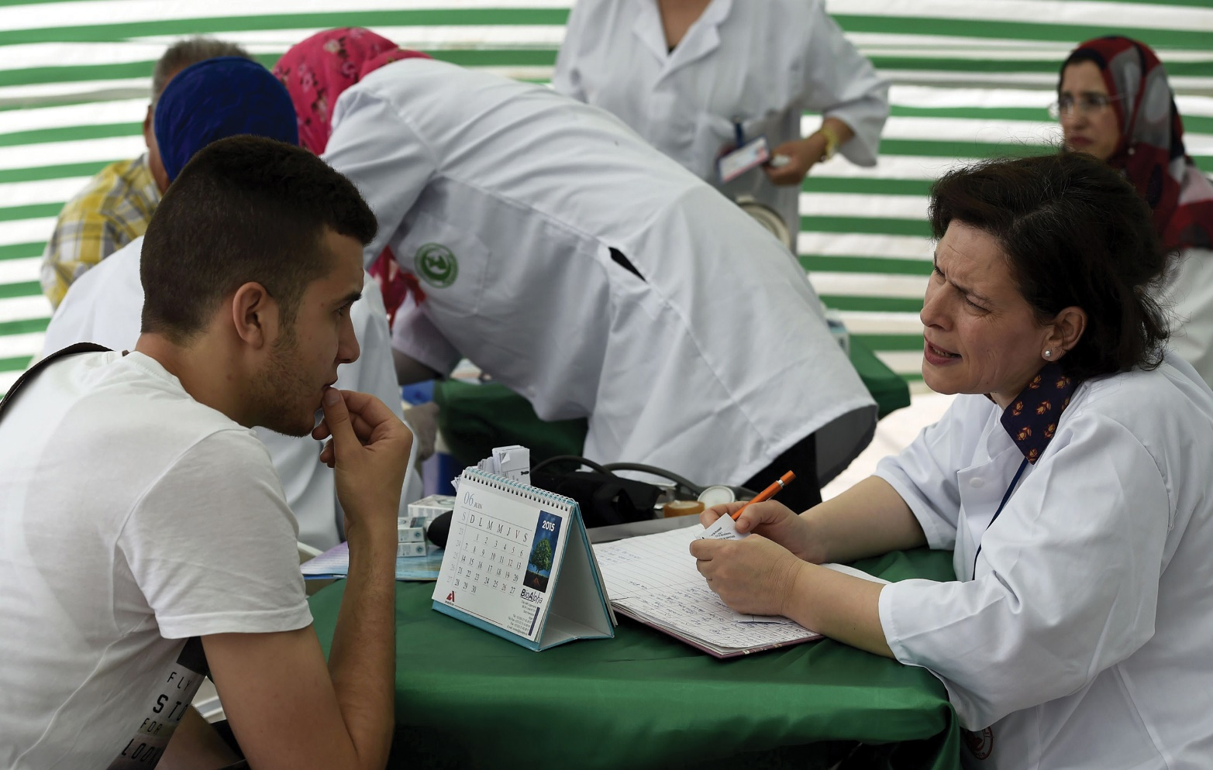
HIV/AIDS
One of the global goals for HIV is that 90% of people with HIV should know their status.
© Farouk Batiche/AFP/Getty Images.

Slide 24
HIV/AIDS
Addressing the Burden of HIV/AIDS
90-90-90 goals by 2020:
90% of the people with HIV will know their HIV status
90% of those with HIV will be receiving antiretroviral therapy
90% of those being treated will have suppressed viral loads

Slide 25
HIV/AIDS
Critical Challenges in HIV/AIDS
Developing a vaccine
Cost-effective approaches to prevention in different settings
Universal treatment for all those who are eligible
Financing treatment
Management of TB and HIV co-infection

Slide 26
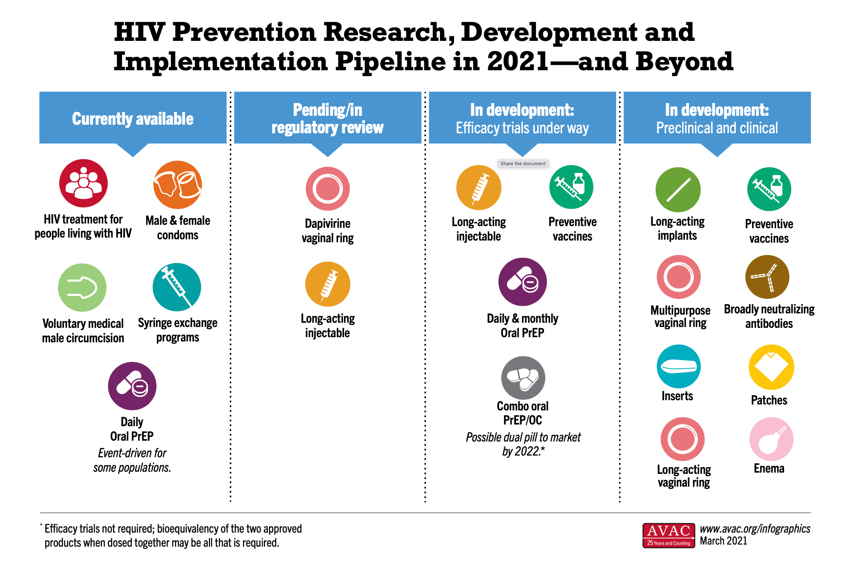
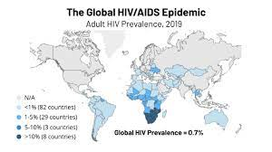

Slide 27
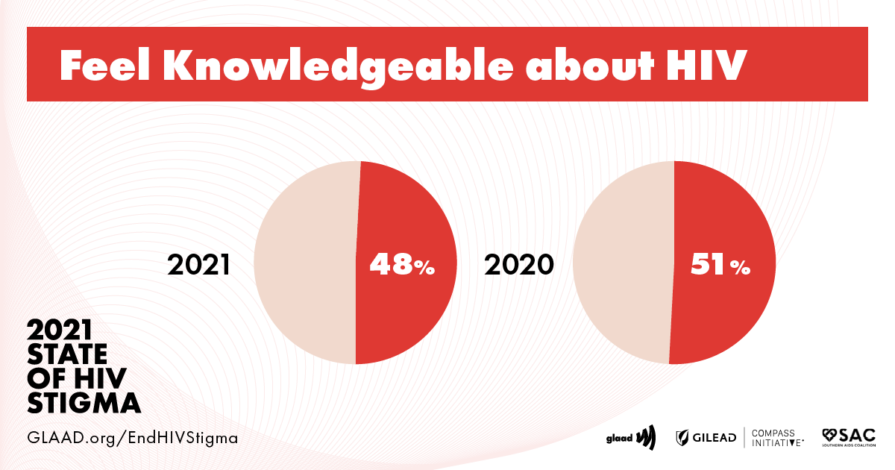
https://www.glaad.org/endhivstigma

Slide 28
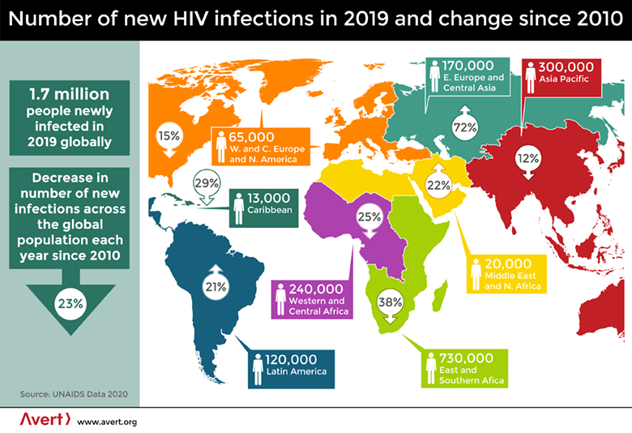
https://www.avert.org/global-hiv-and-aids-statistics

Slide 29
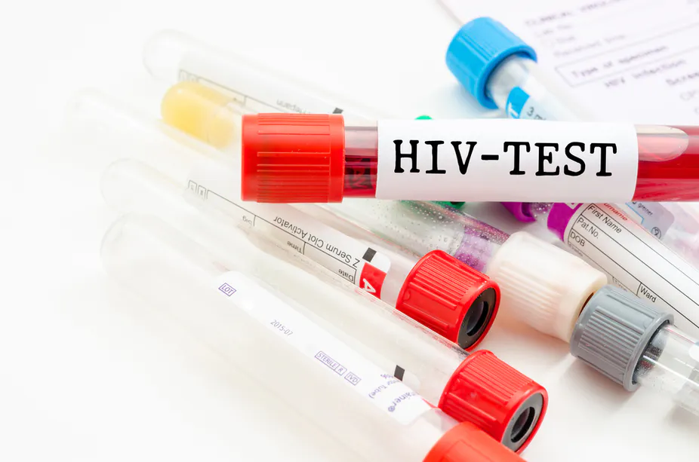

Slide 30
Tuberculosis
The Burden of TB (2017)
Number of new TB cases: 10 million
Number of TB deaths: 1.6 million
Number of new cases resistant to rifampicin (most effective first-line drug): 558,000
Proportion of new rifampicin resistant cases that are multi-drug resistant: 82%

Slide 31
Tuberculosis
The Burden of TB
An untreated person with active pulmonary TB can infect 10 to 15 people annually
About two-thirds of those with active TB disease will die of the disease if not treated properly
TB infection remains latent in the bodies of about 90% of those infected and they do not have active TB disease but can develop it later

Slide 32
Tuberculosis
The Burden of TB
In 2017, TB was the 13th most important cause of death worldwide for all age groups and both sexes
The incidence of TB has fallen by about 2% each year
There has been an increase in TB infections that are resistant to one or more TB drugs

Slide 33
Tuberculosis
The Burden of TB
In 2016, 560,000 of new cases of active TB were infected with drug-resistant TB, of which 82% were multi-drug resistant
Resistance ranges from resistance to one first-line anti-TB drug only to multidrug resistance (MDR) and extensive drug resistance (XDR)
Resistance develops largely due to failure to complete TB treatment

Slide 34
Tuberculosis
The Costs and Consequences of TB
TB patients lose about 60% of their individual annual income and 40% of household income due to falling ill with TB
Could be financially catastrophic to many families
Stigmatized condition
Economic growth of a country inversely correlated with the rate of TB

Slide 35
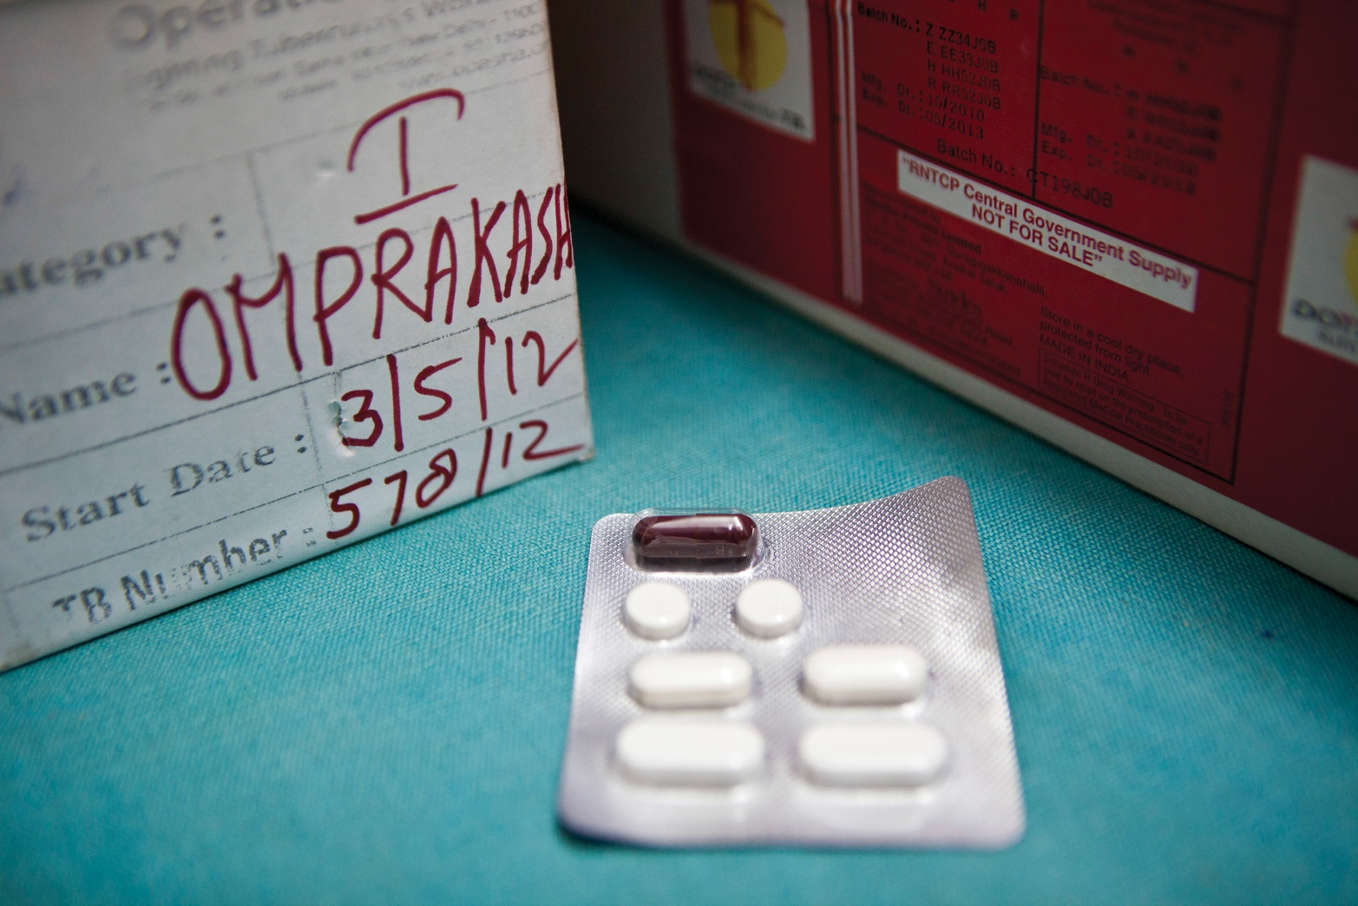
Tuberculosis
People with TB disease need to take four drugs daily for the first 2 months of treatment and two drugs daily for 4 months after that.
© Andrew Aitchison/Corbis Historical/Getty Images.

Slide 36
Tuberculosis
Addressing the Burden of TB
Bacillus Calmette–Guérin (BCG) vaccine has limited impact on incidence or prevalence
Control of TB depends on effective treatment of active tuberculosis and social determinants
WHO recommends a 6-month regimen for drug-susceptible disease; includes four drugs; highly cost-effective: $5–$50 per DALY averted
Patient adherence with TB regimen is essential

Slide 37
Tuberculosis
Management of TB/HIV Co-infection
TB is an opportunistic infection of HIV
“Scaling up the three Is”
Intensified case finding
Giving isoniazid (antibiotic) to people with HIV to help prevent their getting TB
Enhancing infection control in healthcare settings so that TB does not spread

Slide 38
Tuberculosis
Challenges in TB Control
The WHO End TB Strategy seeks to end the global epidemic by 2035, with a 95% reduction in deaths and reduce incidence to 10 per 100,000 people
Focuses on expanding TB prevention and care
Putting the new strategy in place requires additional financial and technical resources

Slide 39
Tuberculosis
Challenges in TB Control
Need for more effective vaccine, inexpensive and rapid diagnostics, and drug therapy that will lessen duration of treatment
Improving identification and treatment of MDR-TB and XDR-TB
Further efforts at linking all providers of TB diagnosis and treatment with national TB control programs

Slide 40
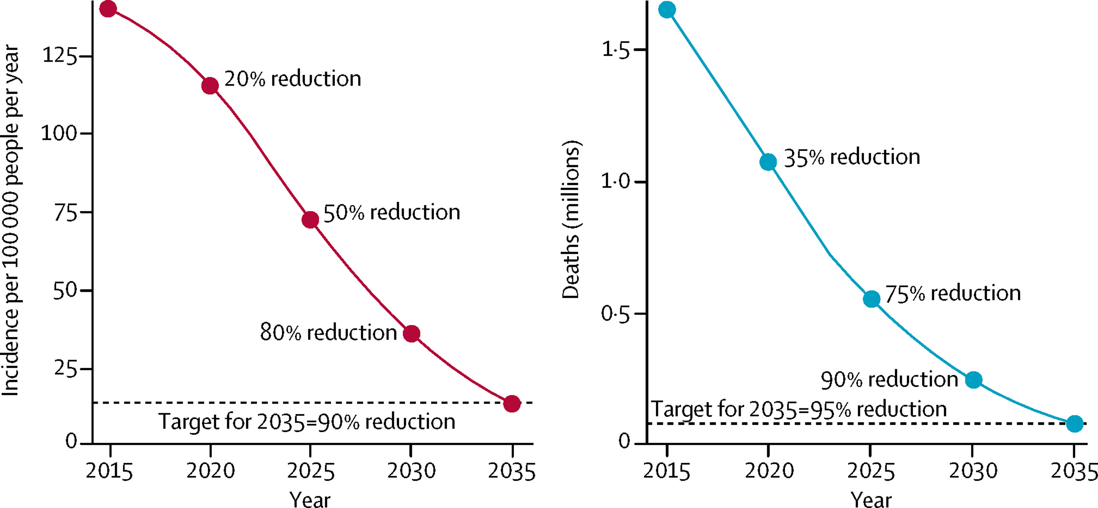
https://www.thelancet.com/journals/lanres/article/PIIS2213-2600(18)30057-2/fulltext

Slide 41
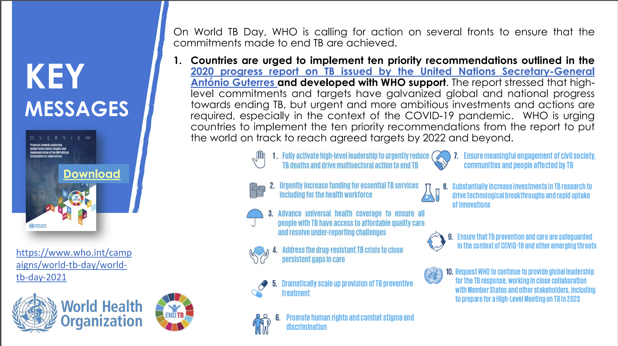
https://www.paho.org/sites/default/files/2021-03/2021-cde-world-tb-day-who-toolkit-en.pdf

Slide 42
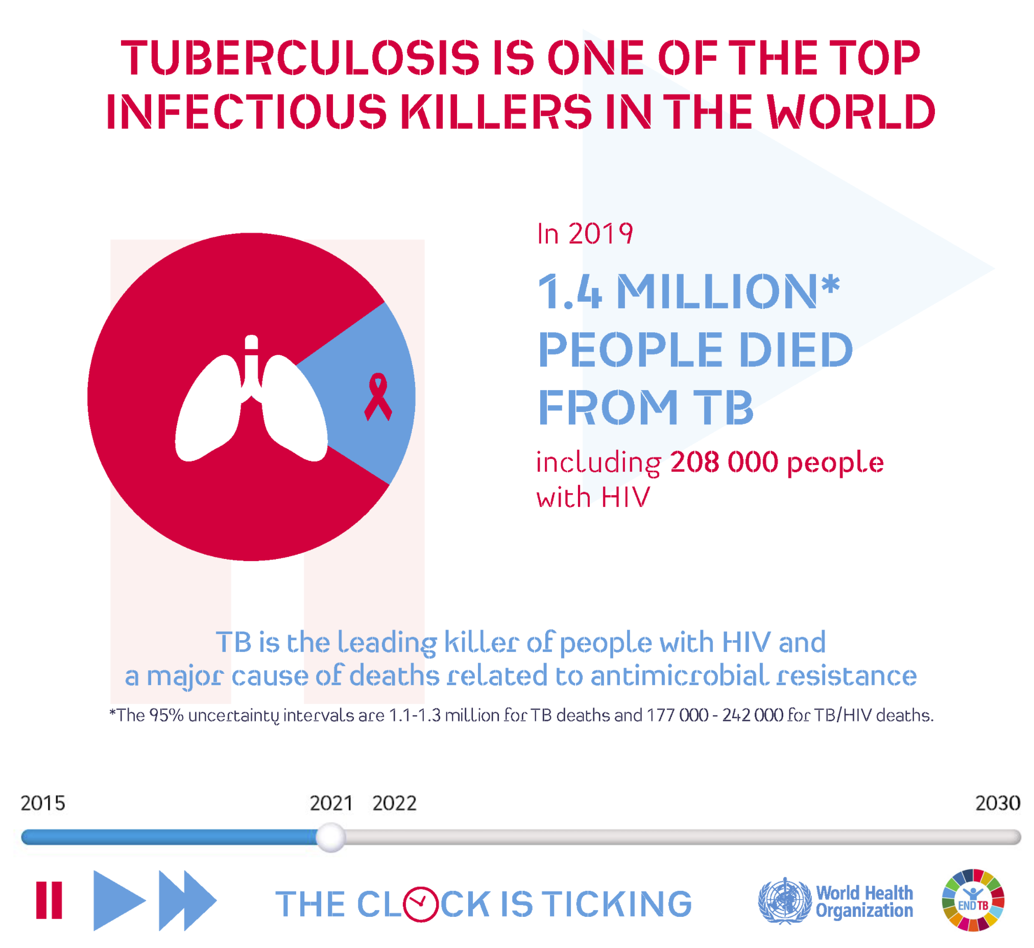

Slide 43
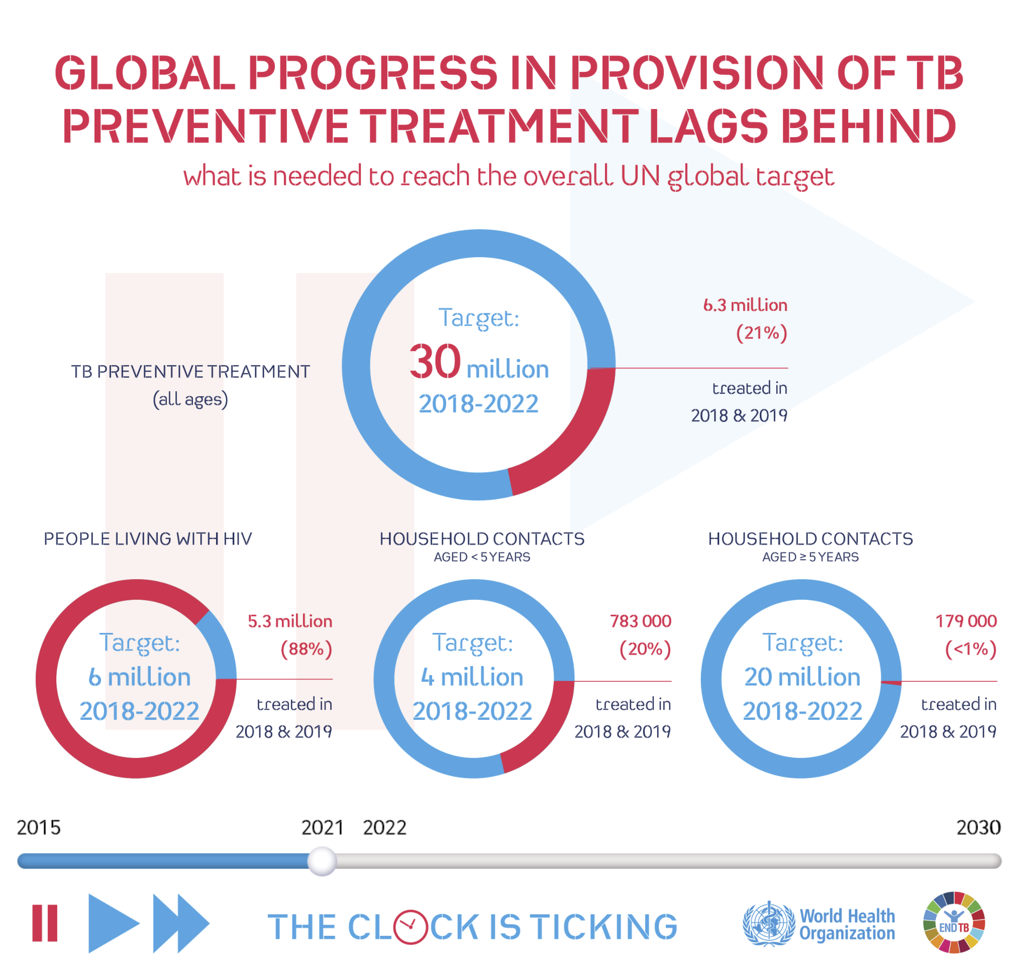

Slide 44
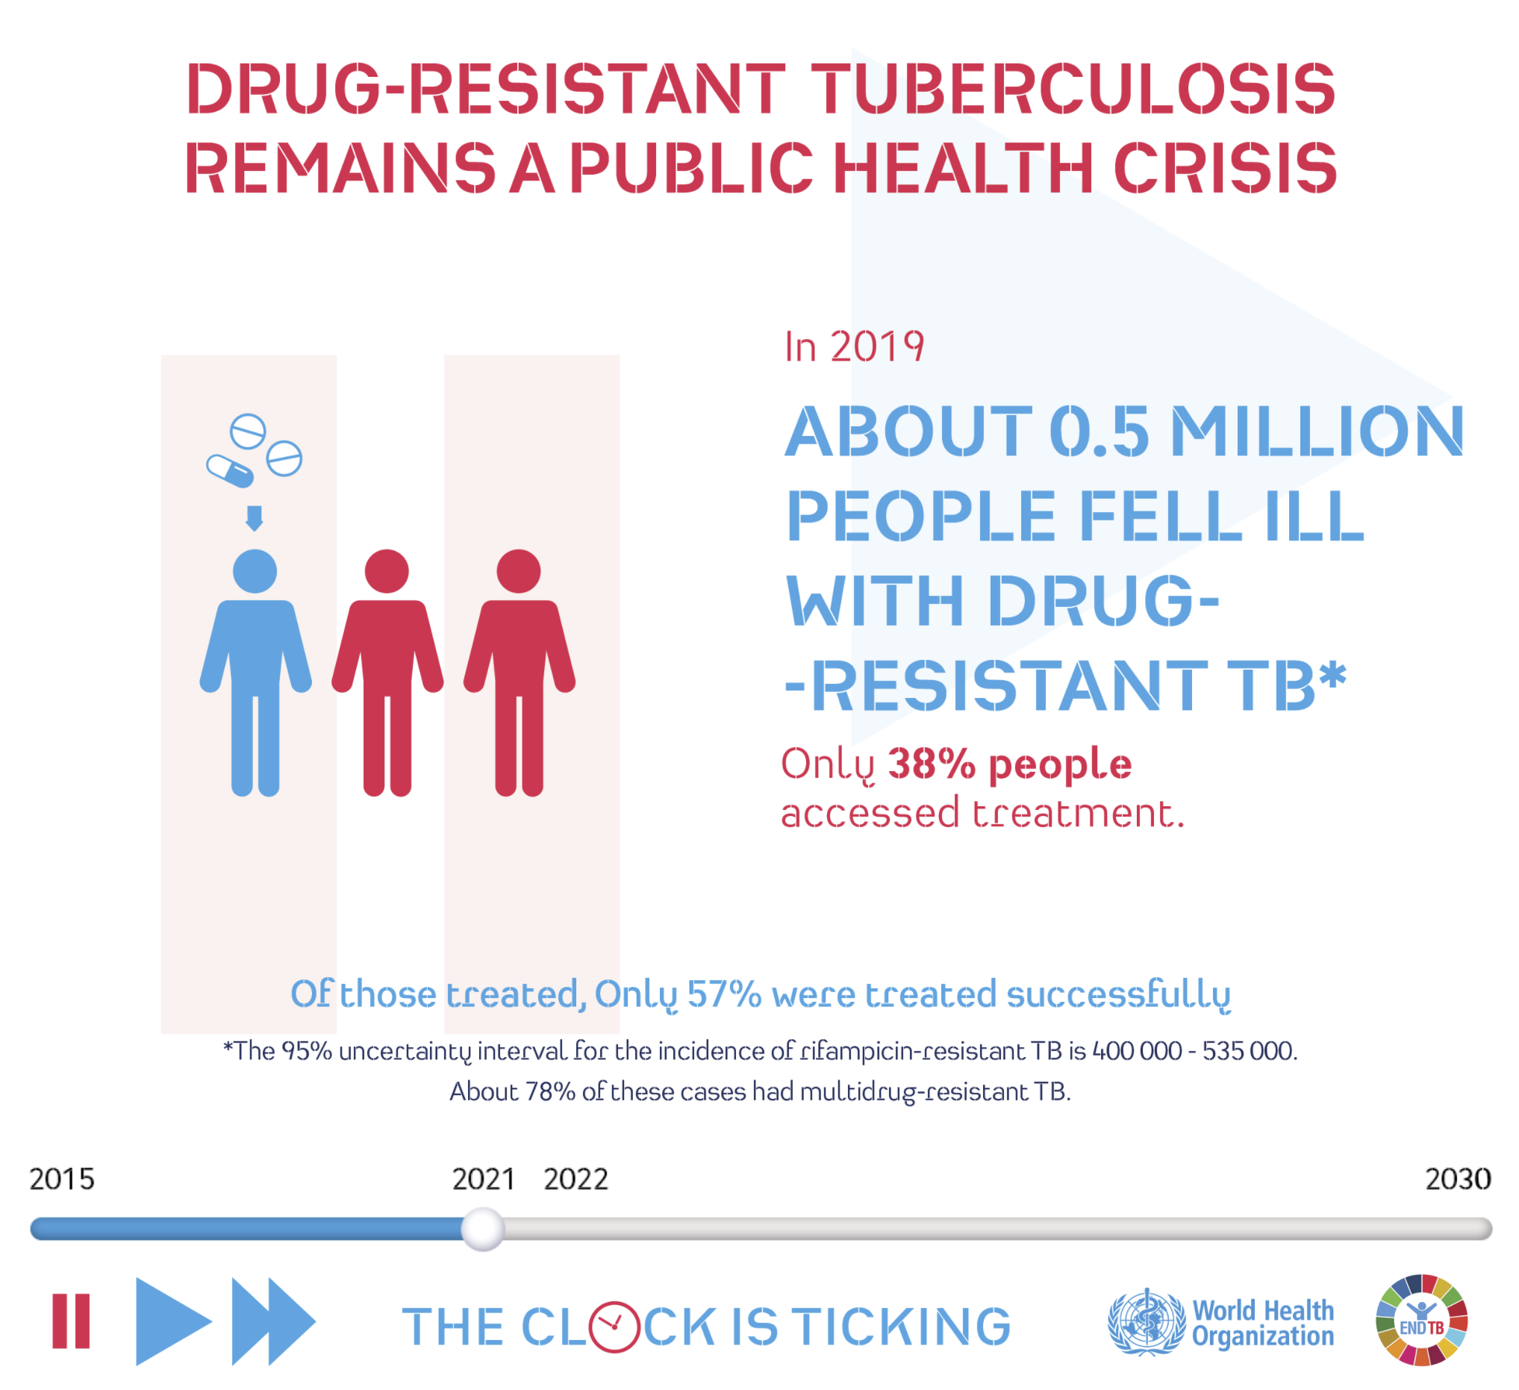

Slide 45
Malaria
The Burden of Malaria (2017)
Number of malaria cases: 219 million
Number of malaria-related deaths: 548,000
Burden of malaria-related deaths: 93% in Africa; 61% occurred in children under 5 years of age

Slide 46
Malaria
The Burden of Malaria
Leading cause of DALYs in sub-Saharan Africa among all age groups
The necessary risk factor for malaria is being bitten by mosquitoes that carry the malaria parasite
Pregnant women who contract malaria are at heightened risk of maternal death and giving birth to low birthweight children

Slide 47
Malaria
Costs and Consequences of Malaria
Individuals often have malaria up to 5 times per year
Indirect costs are greater than direct costs of treatment due to lost days of work
Roll Back Malaria suggests that economic costs in countries with a high burden are equal to 1.3% of GDP per year

Slide 48
Malaria
Addressing the Burden of Malaria
Key interventions:
Prompt treatment of those infected, based on confirmed diagnosis
Intermittent preventive therapy for pregnant women and infants
Seasonal malaria chemoprevention for children under-5 in selected areas
Long-lasting insecticide-treated bednets for people living in malarial zones
Indoor residual spraying in malarial zones
Notes:
Stopped here

Slide 49
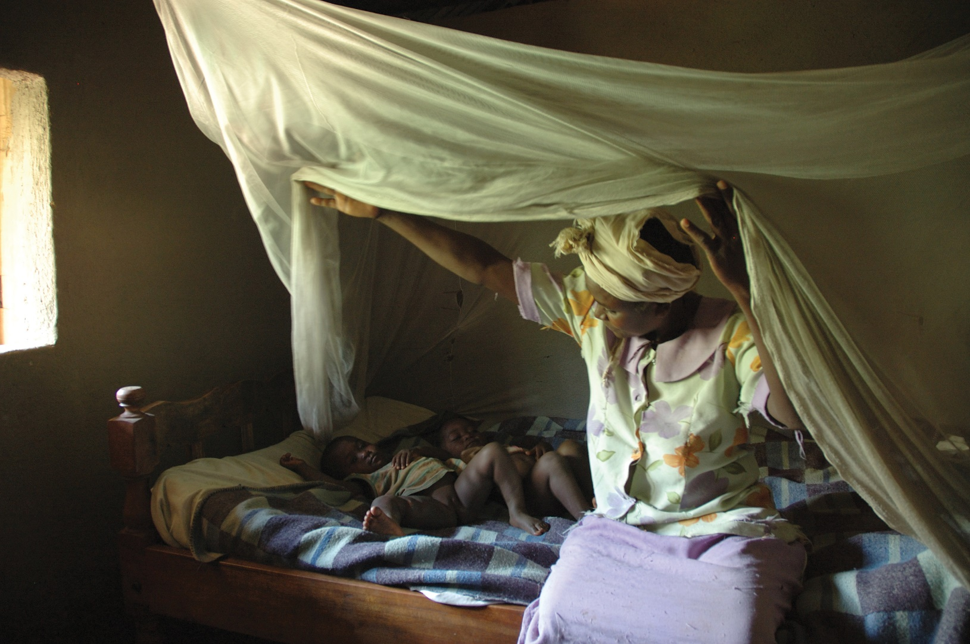
Malaria
The increasing and proper use of insecticide-treated bed nets has had a major impact on the burden of malaria
© Wendy Stone/Corbis Historica/Getty Images.

Slide 50
Malaria
Addressing the Burden of Malaria
Appropriate treatment required so that when mosquitos bite people they will not carry malaria to another person
WHO today recommends artemisinin-based combination therapies (ACT) for treating uncomplicated malaria caused by P. falciparum and for treating P. vivax infections that are not responsive to chloroquine
Notes:
Stopped here

Slide 51
Malaria
Challenges in Addressing Malaria
Substantial gaps in diagnosis and treatment
National malaria programs must find effective ways of working with private medical providers
Dispersal of counterfeit and low quality drugs
Better diagnostics and development of new drugs
Growing resistance to the insecticides used for indoor residual spraying
A safe, effective, and affordable vaccine

Slide 52
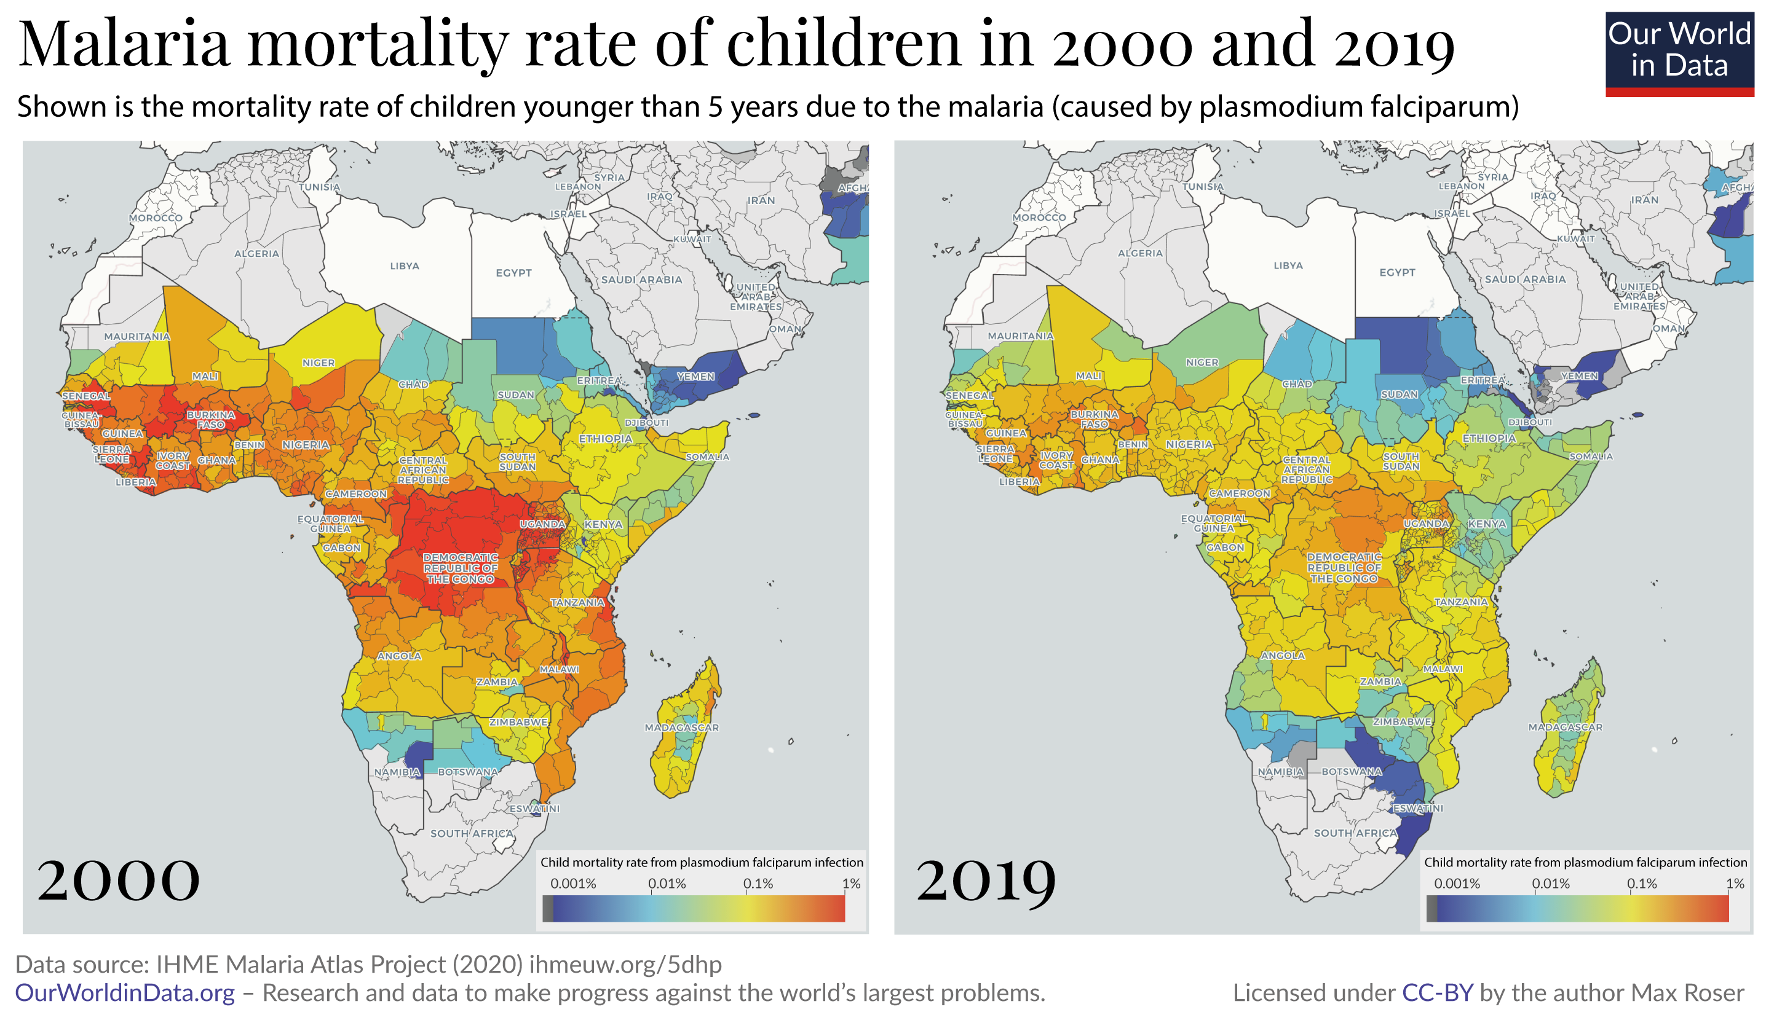
https://ourworldindata.org/malaria

Slide 53
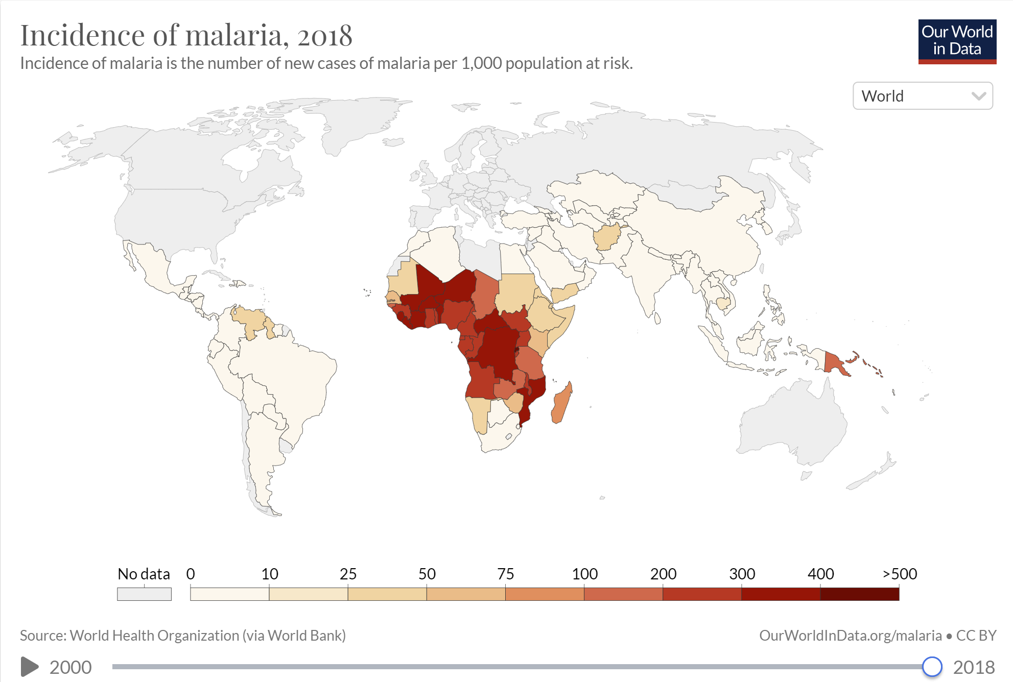

Slide 54
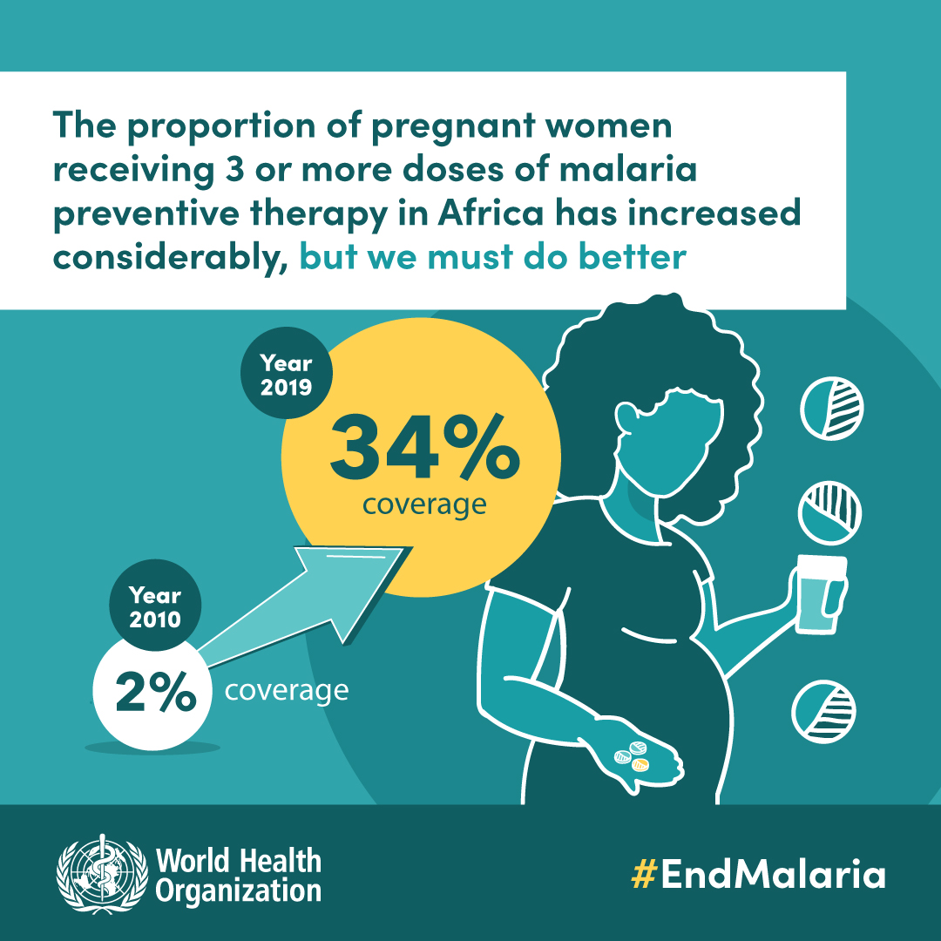

Slide 55
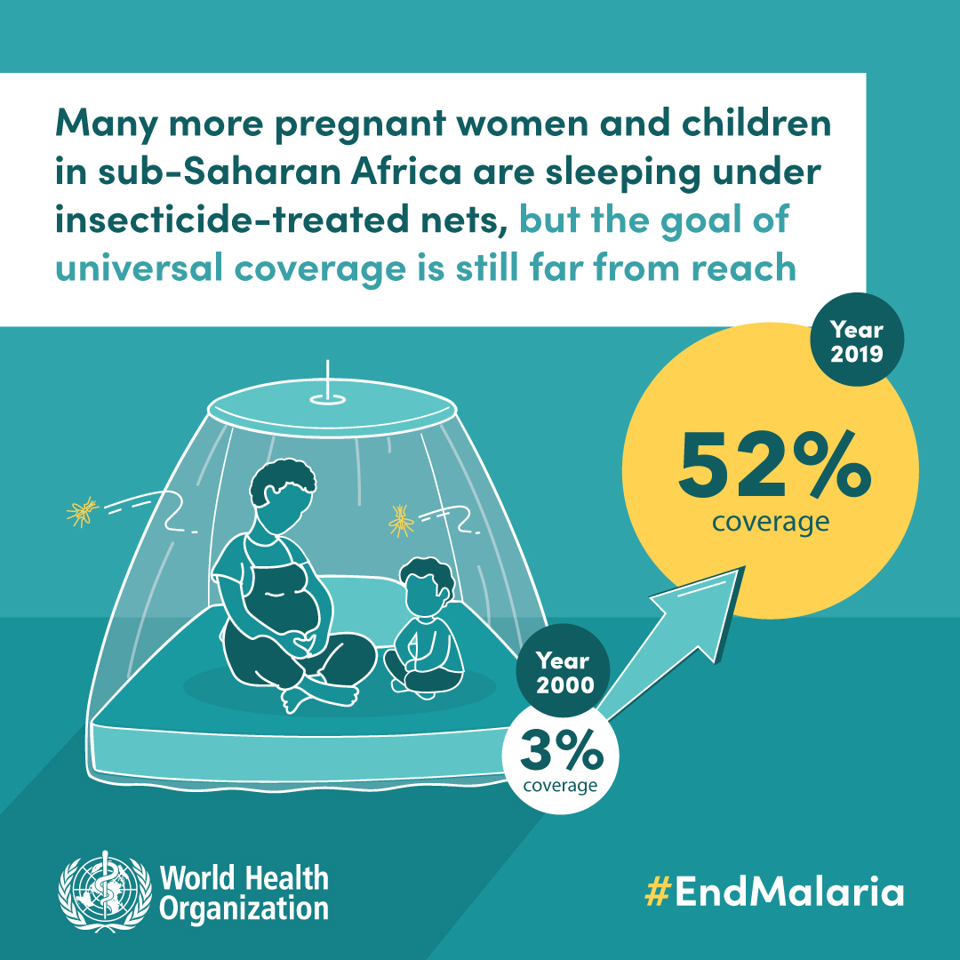

Slide 56
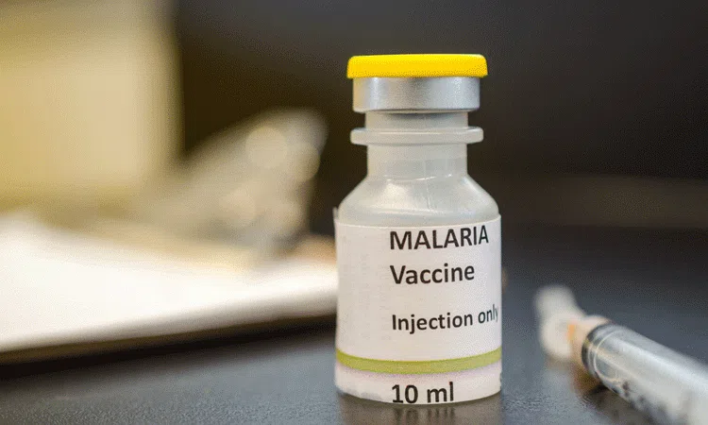

Slide 57
Neglected Tropical Diseases
The Burden of Neglected Tropical Diseases
There are 22 parasitic and bacterial infections referred to as NTDs
Worldwide: more than 1 billion infected (about 1 in 7); about 500 million children
Diseases of poverty
Terrible impact on health, impede child growth and development, harm pregnant women, and often cause long-term debilitating illnesses

Slide 58
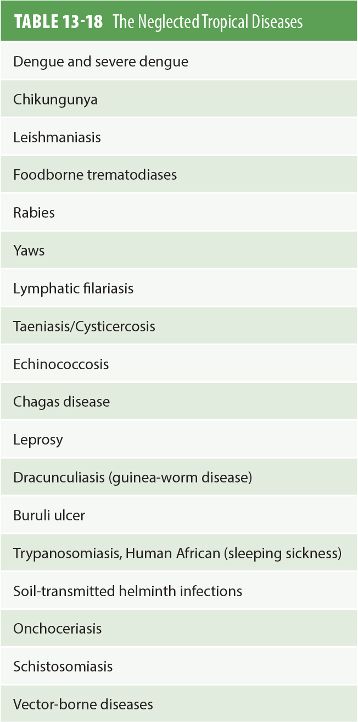
Neglected Tropical Diseases
Modified from World Health Organization (WHO). (n.d.). Fact sheets: Neglected tropical diseases.Retrieved from https://www.who.int/topics/tropical_diseases/factsheets/neglected/en/

Slide 59
Neglected Tropical Diseases
The Consequences of the Neglected Tropical Diseases
Chronic helminth infection in children can limit the physical and mental development of the child
Pregnant women with anemia, commonly caused by hookworm in low-income countries, are 3.5 times more likely to die during childbirth

Slide 60
Neglected Tropical Diseases
The Consequences of the Neglected Tropical Diseases
Other possible complications: blindness, liver cancer, remarkable swelling, and skin problems
Increase susceptibility to other infectious diseases
Social stigma
Impact on productivity, school attendance, and future wage-earning capacity

Slide 61
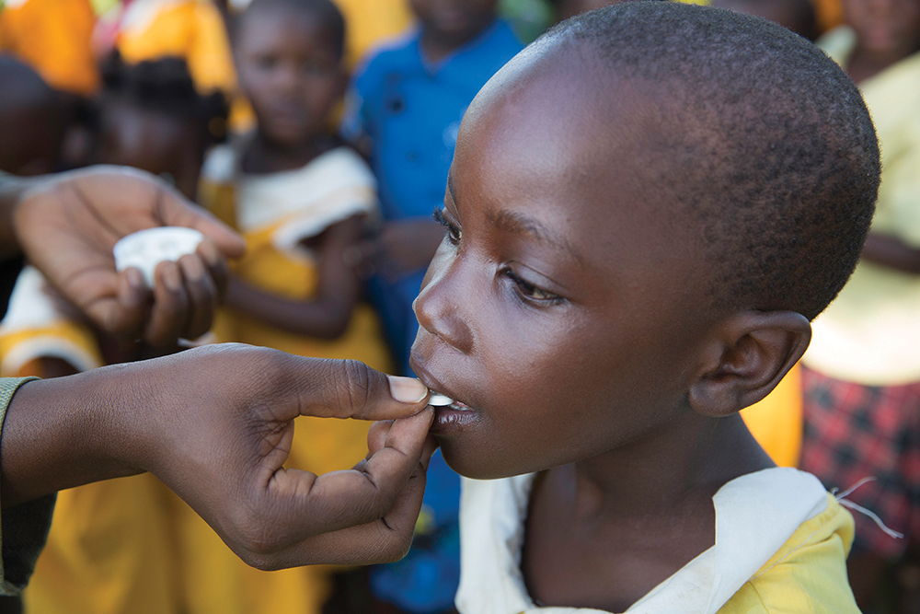
Neglected Tropical Diseases
Preventing the continued spread of some of the “wormy” diseases is based on the mass administration of drugs to populations at risk, as shown here in Uganda
Courtesy of Mark Tuschman.

Slide 62
Neglected Tropical Diseases
Addressing the Neglected Tropical Diseases
Rapid-impact package of drugs for the seven most common NTDs
Importance of public-private partnerships, such as pharmaceutical companies donating the drugs for rapid-impact package
Periodic deworming of young children is also a “best buy” in global health
Opportunities to integrate NTD treatment programs with existing HIV and malaria control programs

Slide 63
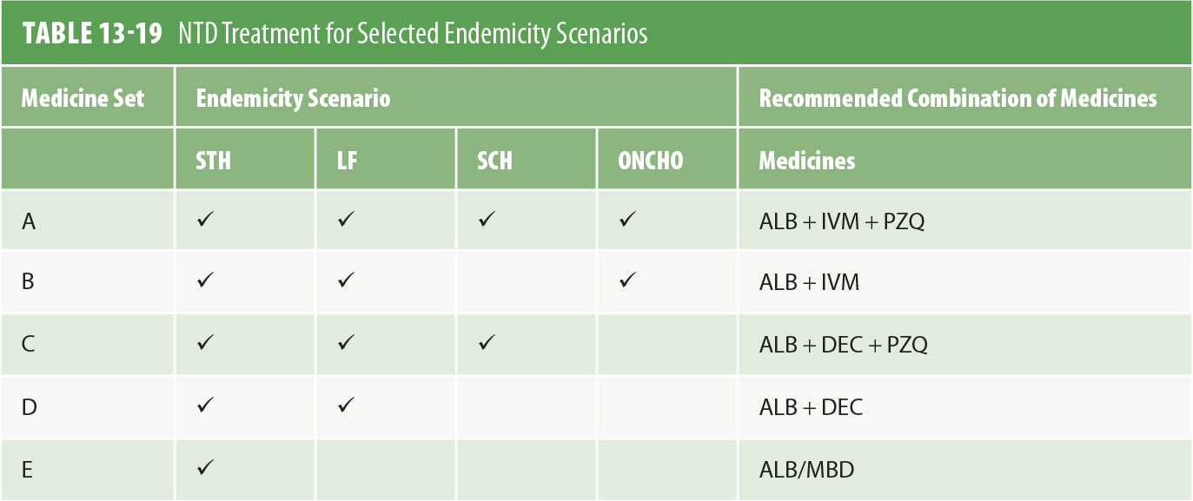
Neglected Tropical Diseases
Note: ALB = albendazole; DEC = diethylcarbamazine; IVM = ivermectin; LF = lymphatic filariasis; MBD = mebendazole; ONCHO = onchocerciasis; PZQ = praziquantel; SCH = schistosomiasis;
STH = soil-transmitted helminths
The Rapid Impact Package would also include azithromycin to treat trachoma.
Data from Weaver, S. D. (2008). The ABCs of NTDs. Presentation at the USAID Mini-University, September 12, 2008.

Slide 64
Neglected Tropical Diseases
Future Challenges for Neglected Tropical Diseases
Hookworm and schistosomiasis vaccines
Develop new drugs to combat the NTDs more effectively and combat resistance
Work with communities to combat underlying risks such as hygiene, unsafe water supply, unsanitary disposal of human waste, and worm and parasite breeding sites

Slide 65
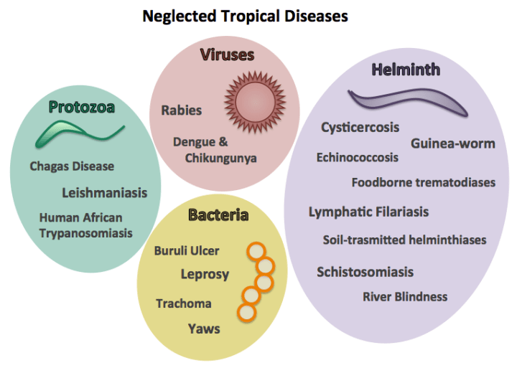
https://healthpolicy-watch.news/ending-neglected-tropical-diseases/

Slide 66
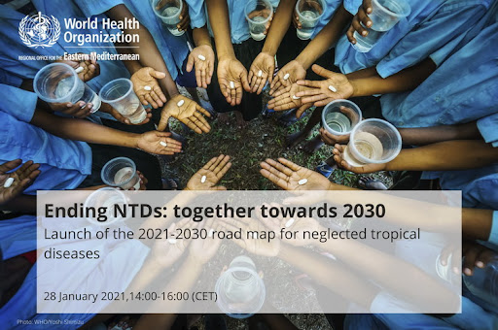
http://www.emro.who.int/media/news/who-launches-new-road-map-to-prevent-control-eliminate-and-eradicate-20-neglected-tropical-diseases-by-2030.html

Slide 67
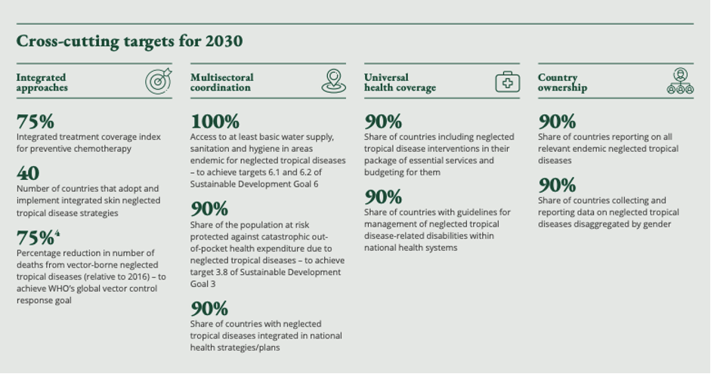

Slide 68
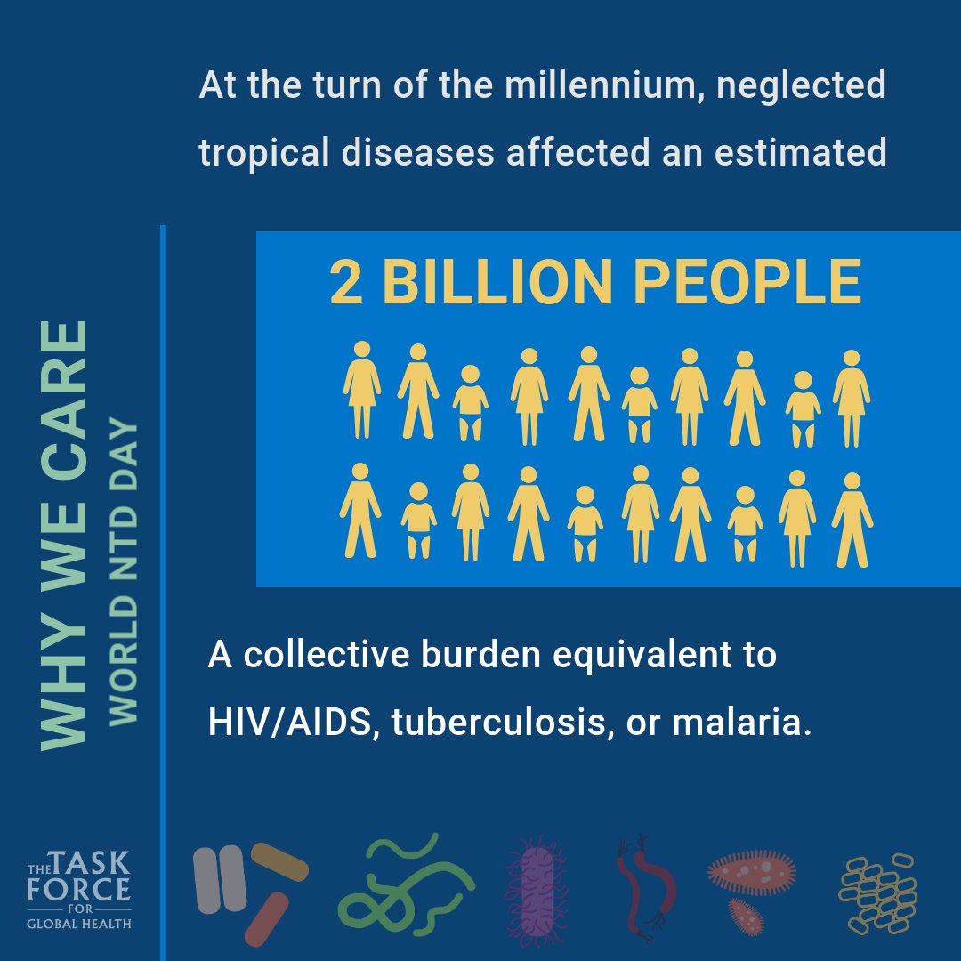

Slide 69
Future Challenges to the Control of Communicable Diseases
Enhance political commitment to the prevention and control of these diseases
Work with communities to overcome underlying causes
Because health systems in many low- and middle-income countries will continue to be weak, it will be important for efforts to be based on partnerships, often with the private sector

Slide 70
Future Challenges to the Control of Communicable Diseases
Strengthening the surveillance of disease at the local, national, and global levels
The lack of adequately trained and appropriately deployed human resources for health
The challenge of financing enhanced efforts
Scientific and technical challenges
Develop models in low- and middle-income countries to provide chronic care of people with HIV/AIDS

Slide 71
Global Health Partnerships
There are several major global non profit public private partnerships working to tackle major global health issues
The goals of these partnerships are to;
Develop new products – vaccines, medicines , diagnostic tools, distributing subsidised health products, strengthening health services or health information systems, educating the public about specific health issues, improving the quality or regulation of products and coordinating global health efforts
Jacobsen (2014)

Slide 72
Public Private Partnerships
Global Fund to fight AIDS, Malaria and TB (GFATM)
Global Alliance for Vaccines and Immunisation (GAVI)
Global Alliance for Improved Nutrition (GAIN)
Roll Back Malaria (RBM)
Stop TB Partnership (Stop TB)
International AIDS Vaccine Initiative (IAVI)
Medicines for malaria venture
Notes:
Foundation for innovative new diagnostics ( FIND)
Health Metrics Network (HMN)

Slide 73
Private Foundations
Bill and Melinda Gates Foundation ( Largest foundation in the world)
The Wellcome Trust (2nd largest foundation)
The Ford Foundation
The Rockefeller Foundation
Chan and Zuckerberg Foundation
The Aga Khan Foundation
Clinton Foundation
Soros Foundation

Slide 74

It’s essay time
Hand your plan to a friend
Take time to read someone else’s plan and think:
Do I understand this plan?
Is there anything missing or not detailed enough?
What needs more attention?
What would you do differently?
Give and receive feedback and make sure that you know what your next steps are

Slide 75
Working with an example around the global context of your case study: What questions could you ask
Use
Use the list of terms to ask questions about the burden of the problem/disease/issue globally, the global community involved, the global consequences (descriptive)
Think
Think of neighbouring countries or the region through the effects on health / economy / society (descriptive, advanced)
Think
Think of the intervention in global terms – who was involved? What did they invest (money, experience, knowledge)? How did their investment affected other countries or regions? (descriptive and possibly critical)

Slide 76
GH terms and concepts Make sure that you have enough knowledge to use the ones we do not discuss today
Development Goals
Developing Nations (or any other term)
Disease - epidemiology
Displacement
Endemic, Epidemic/Outbreak and Pandemic - epidemiology
Global Disease Burden
Global Health Community
Global Health Security
Health Equity
Health Indicator – epidemiology, SDGs
Morbidity and Mortality - epidemiology
Nongovernmental Organization (NGO) – focus on those that are global
Prevention
Primary Health Care
Social Determinants of Health

Slide 77
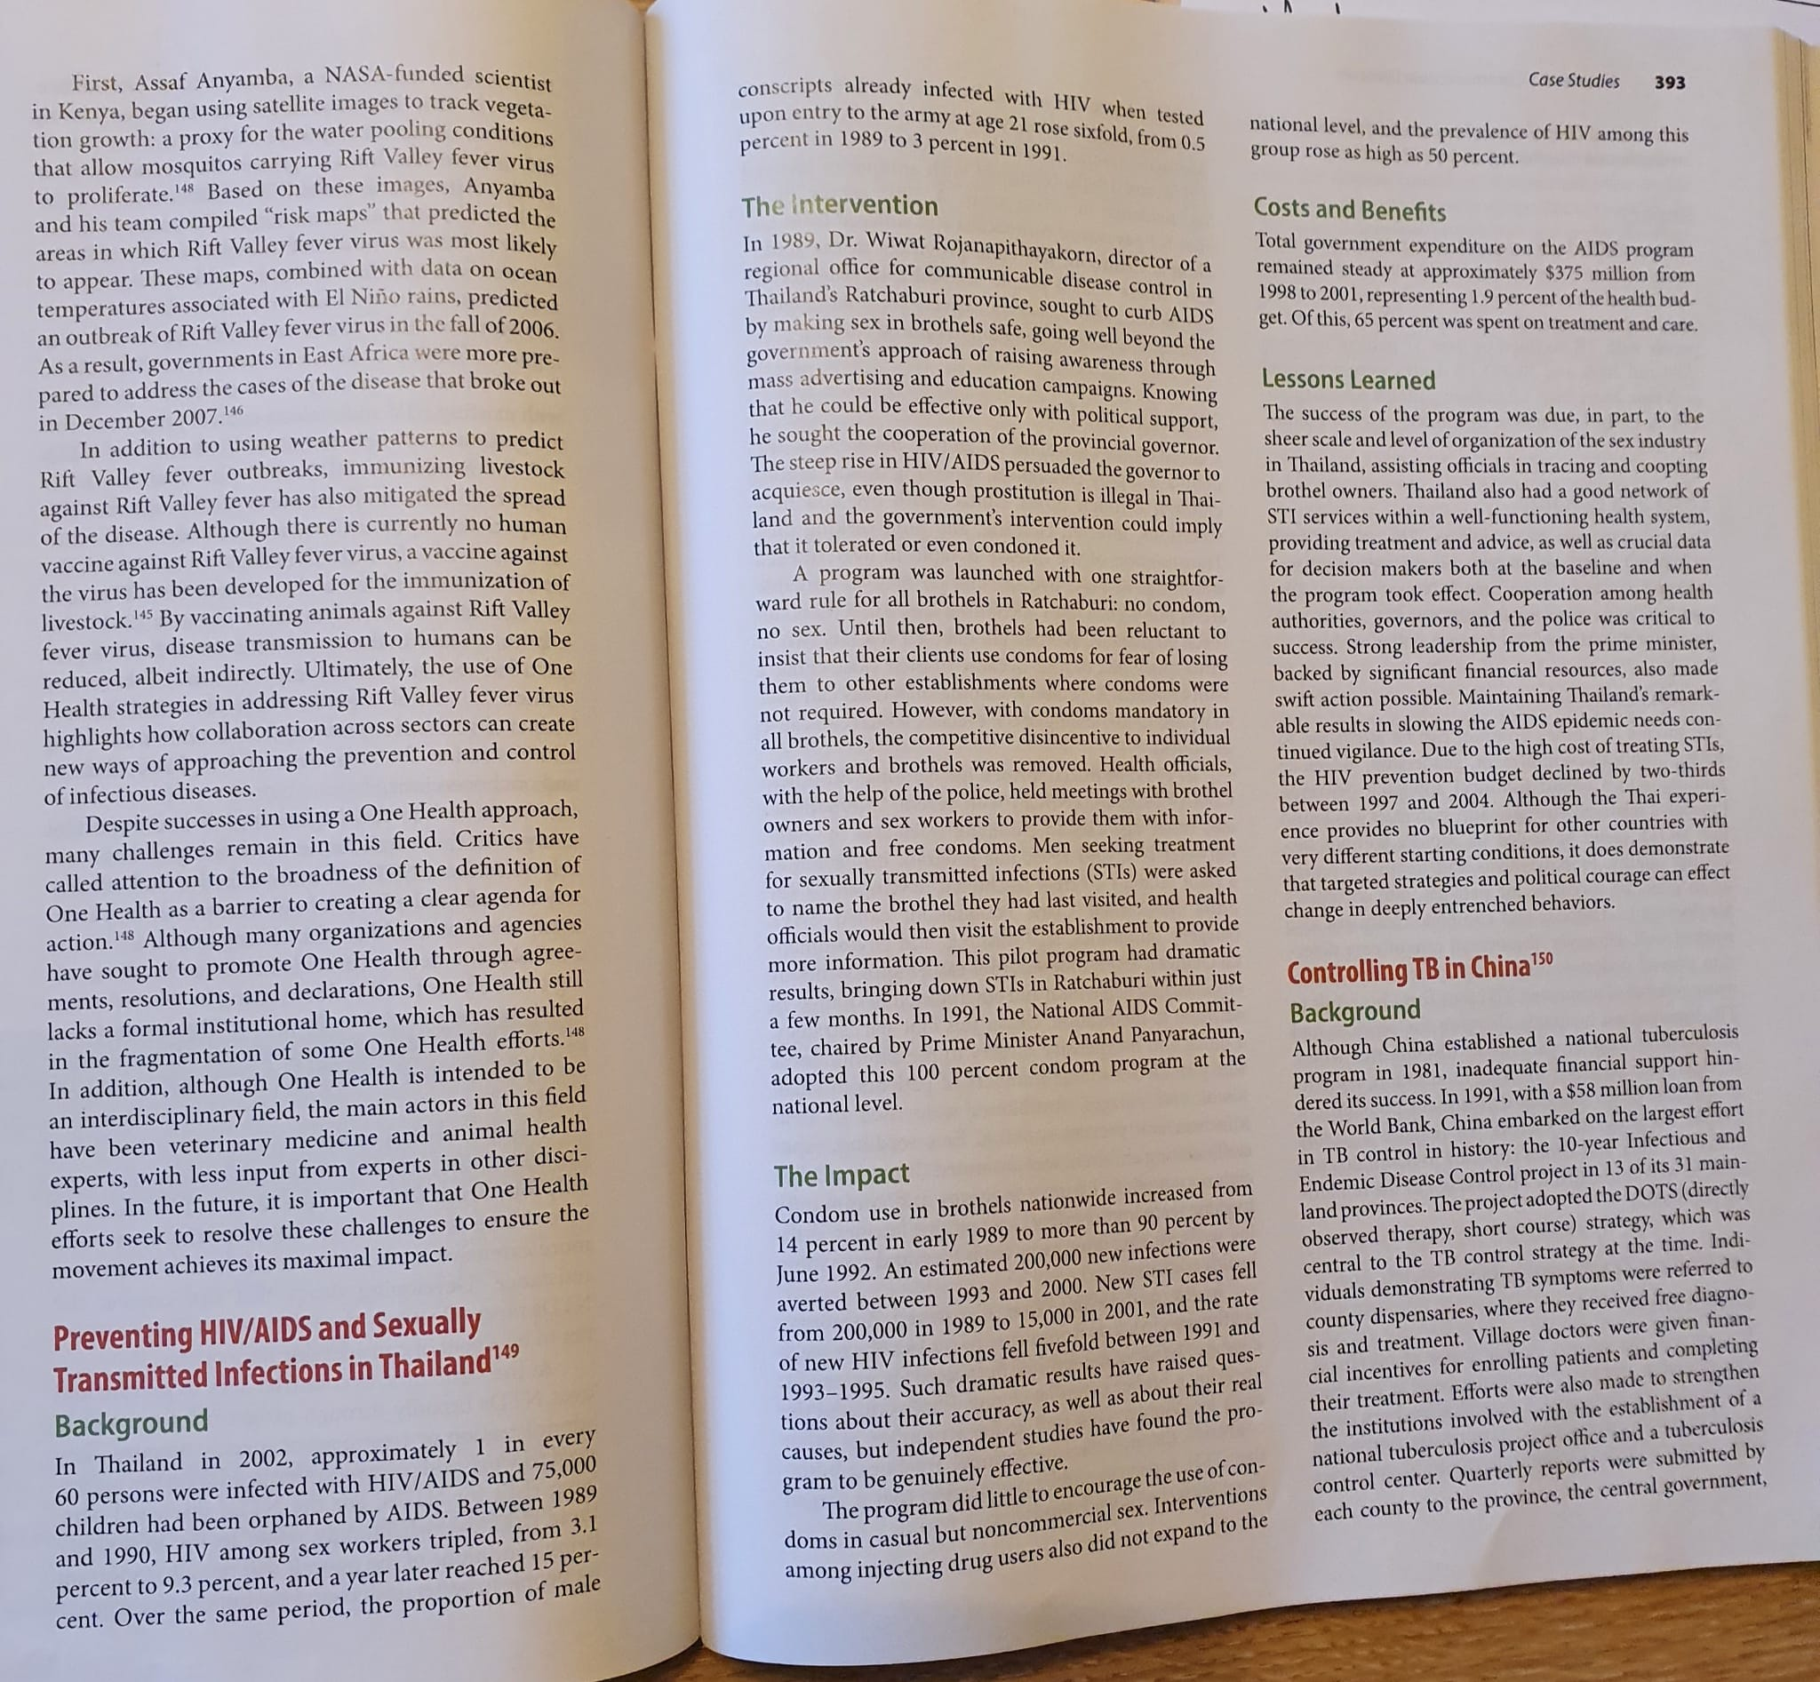
Playing with the global context of your essay’s case study

Slide 78
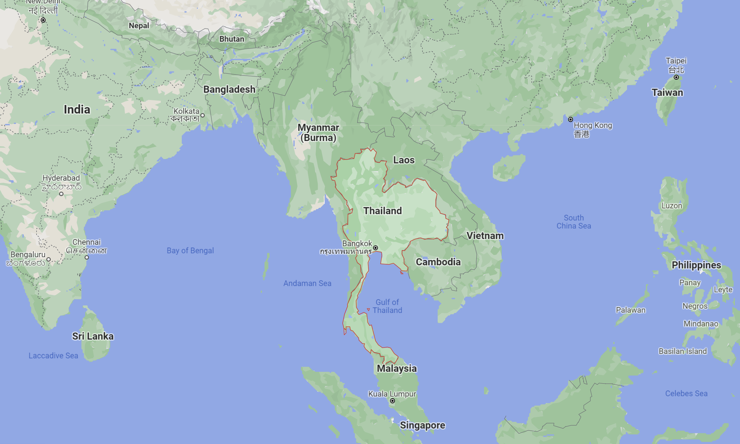
Thailand and Southeast Asia

Slide 79
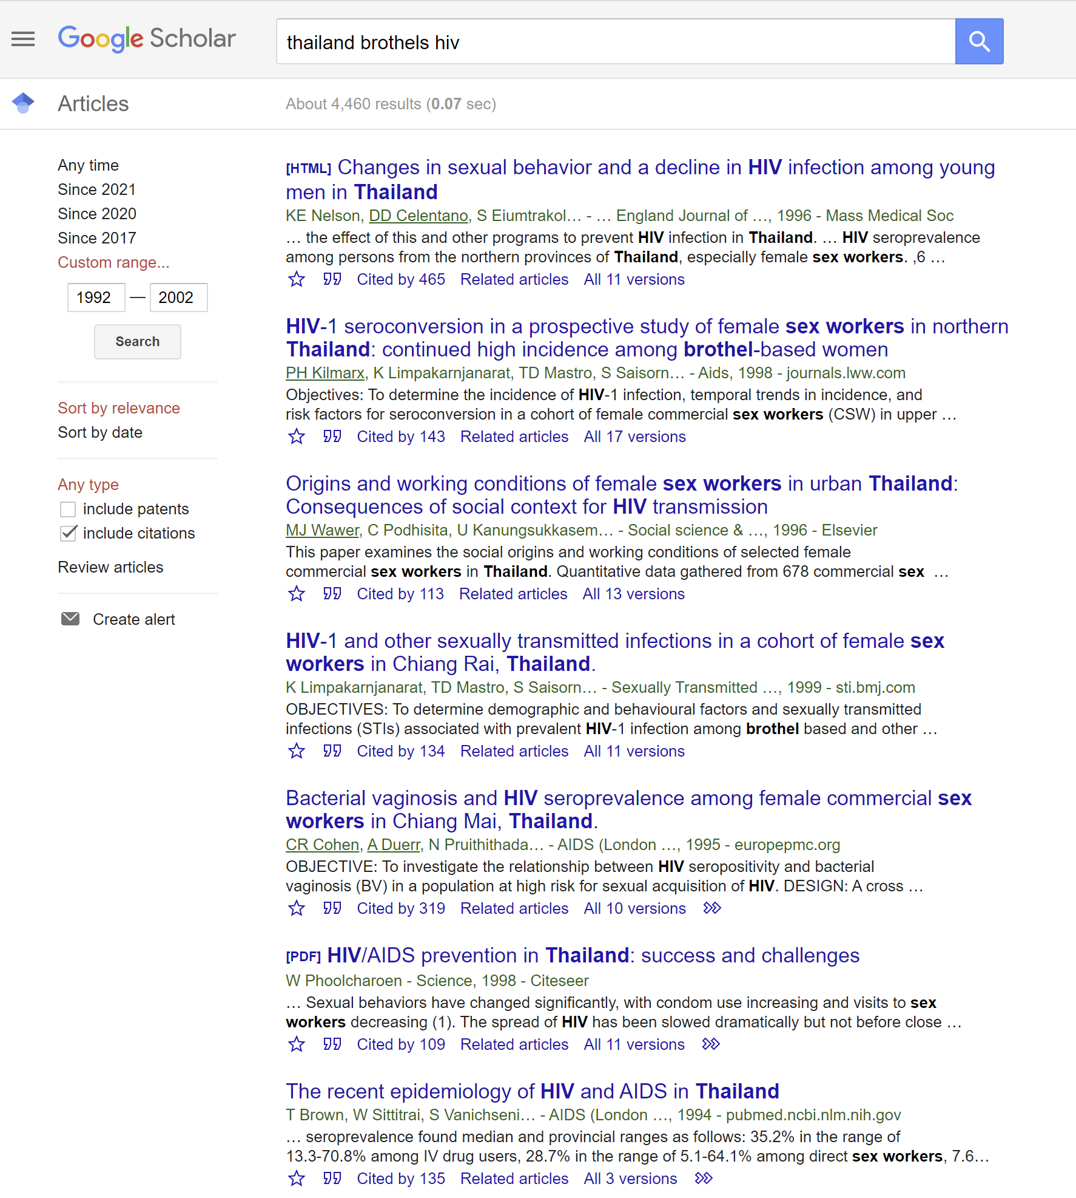

Slide 80
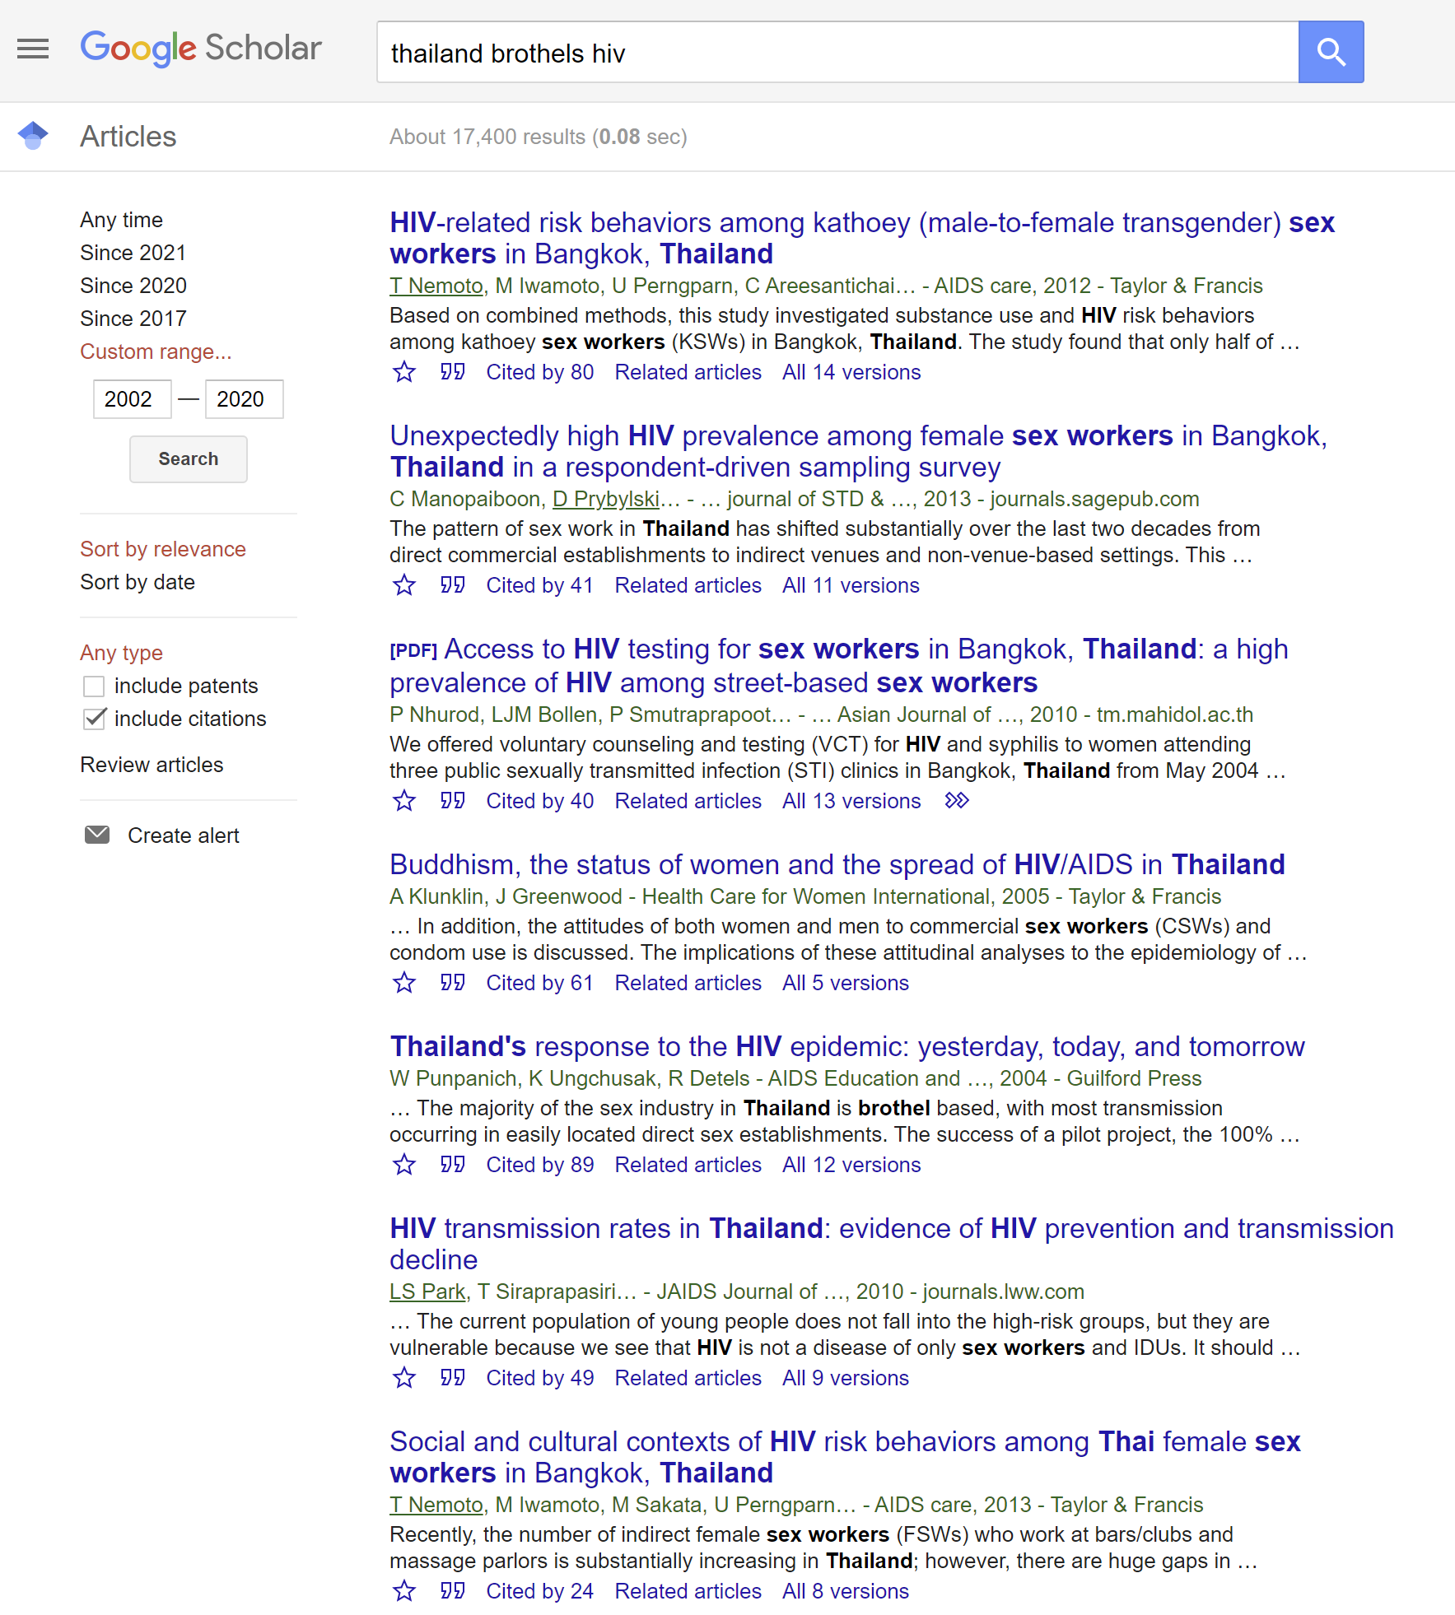

Slide 81
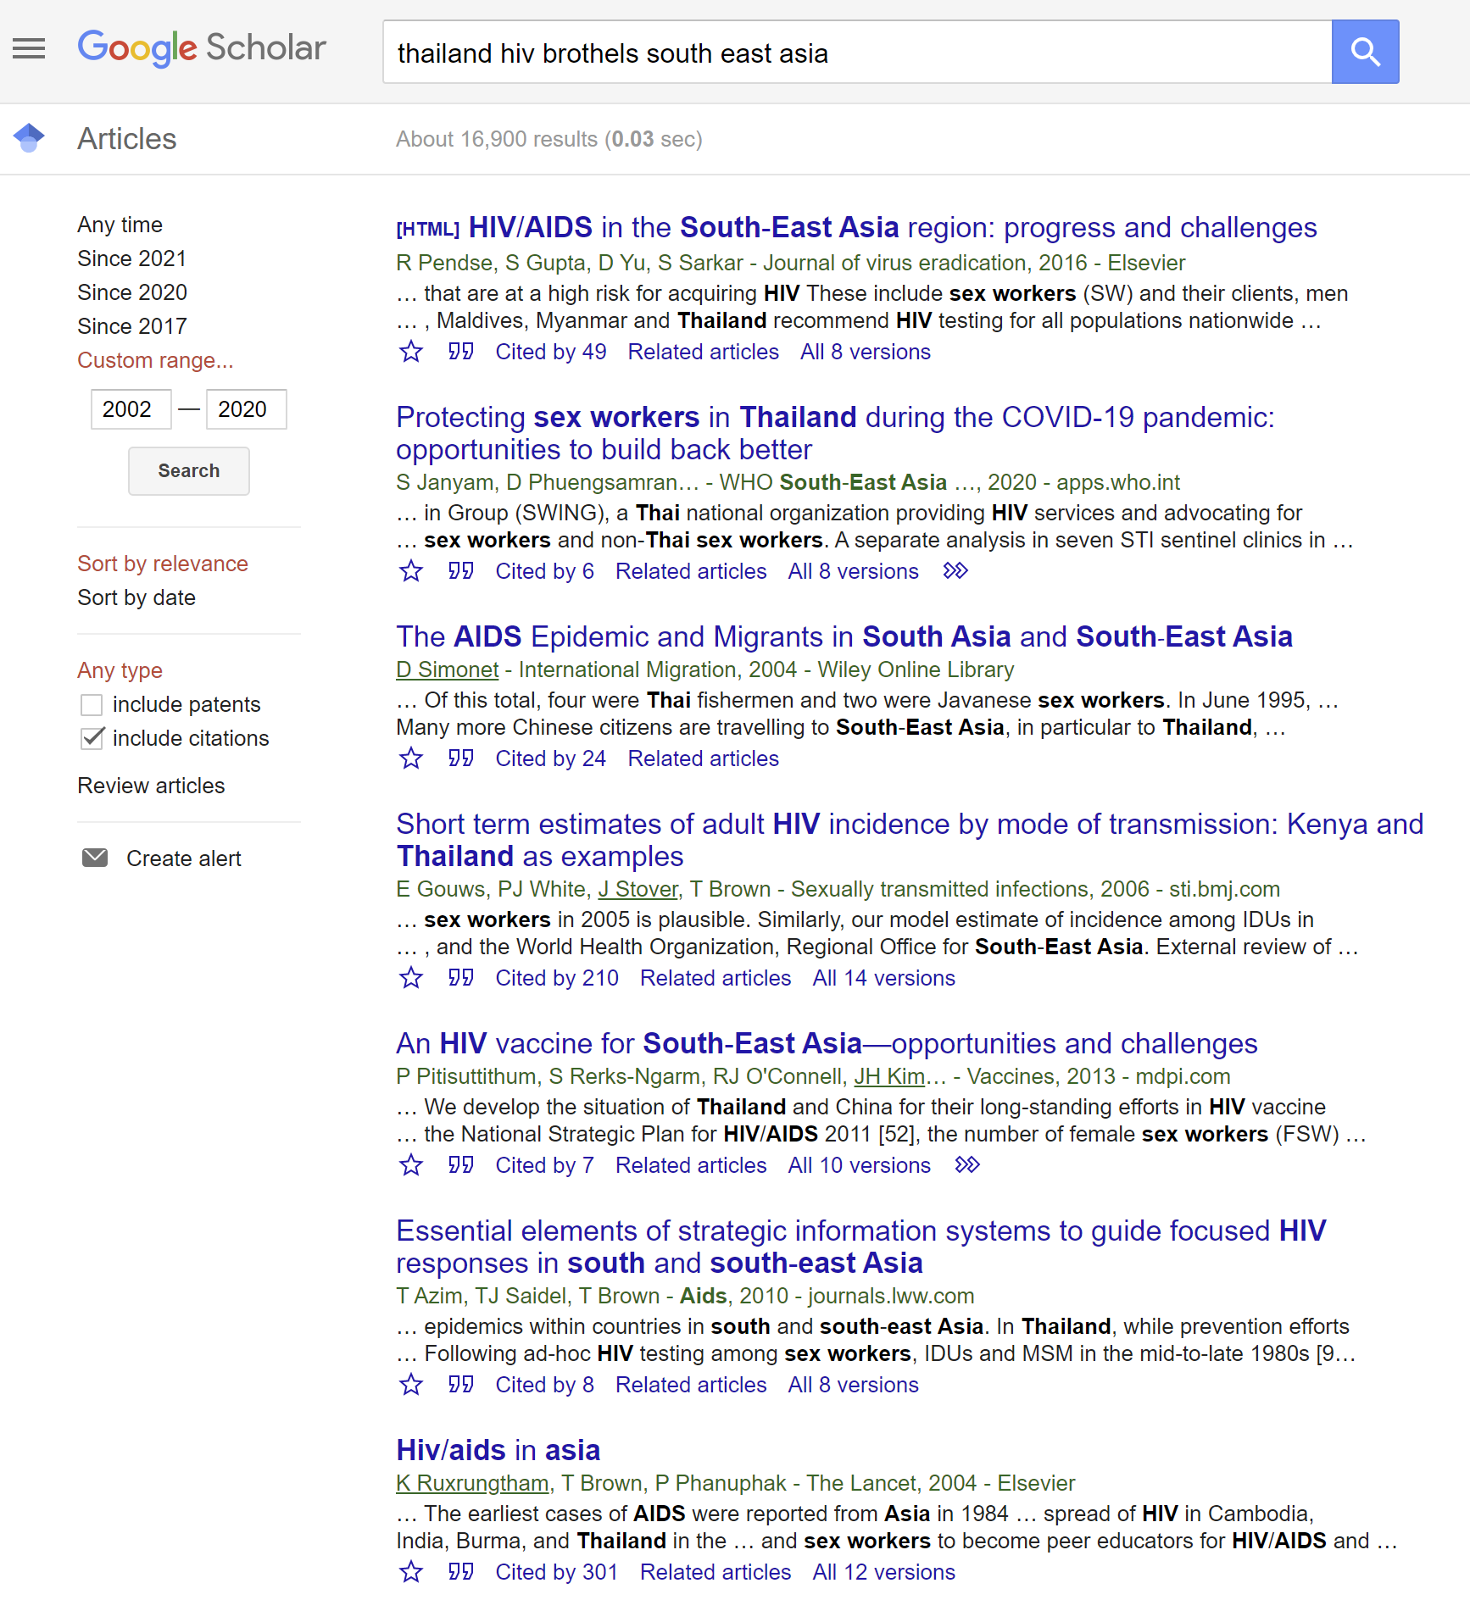

Slide 82
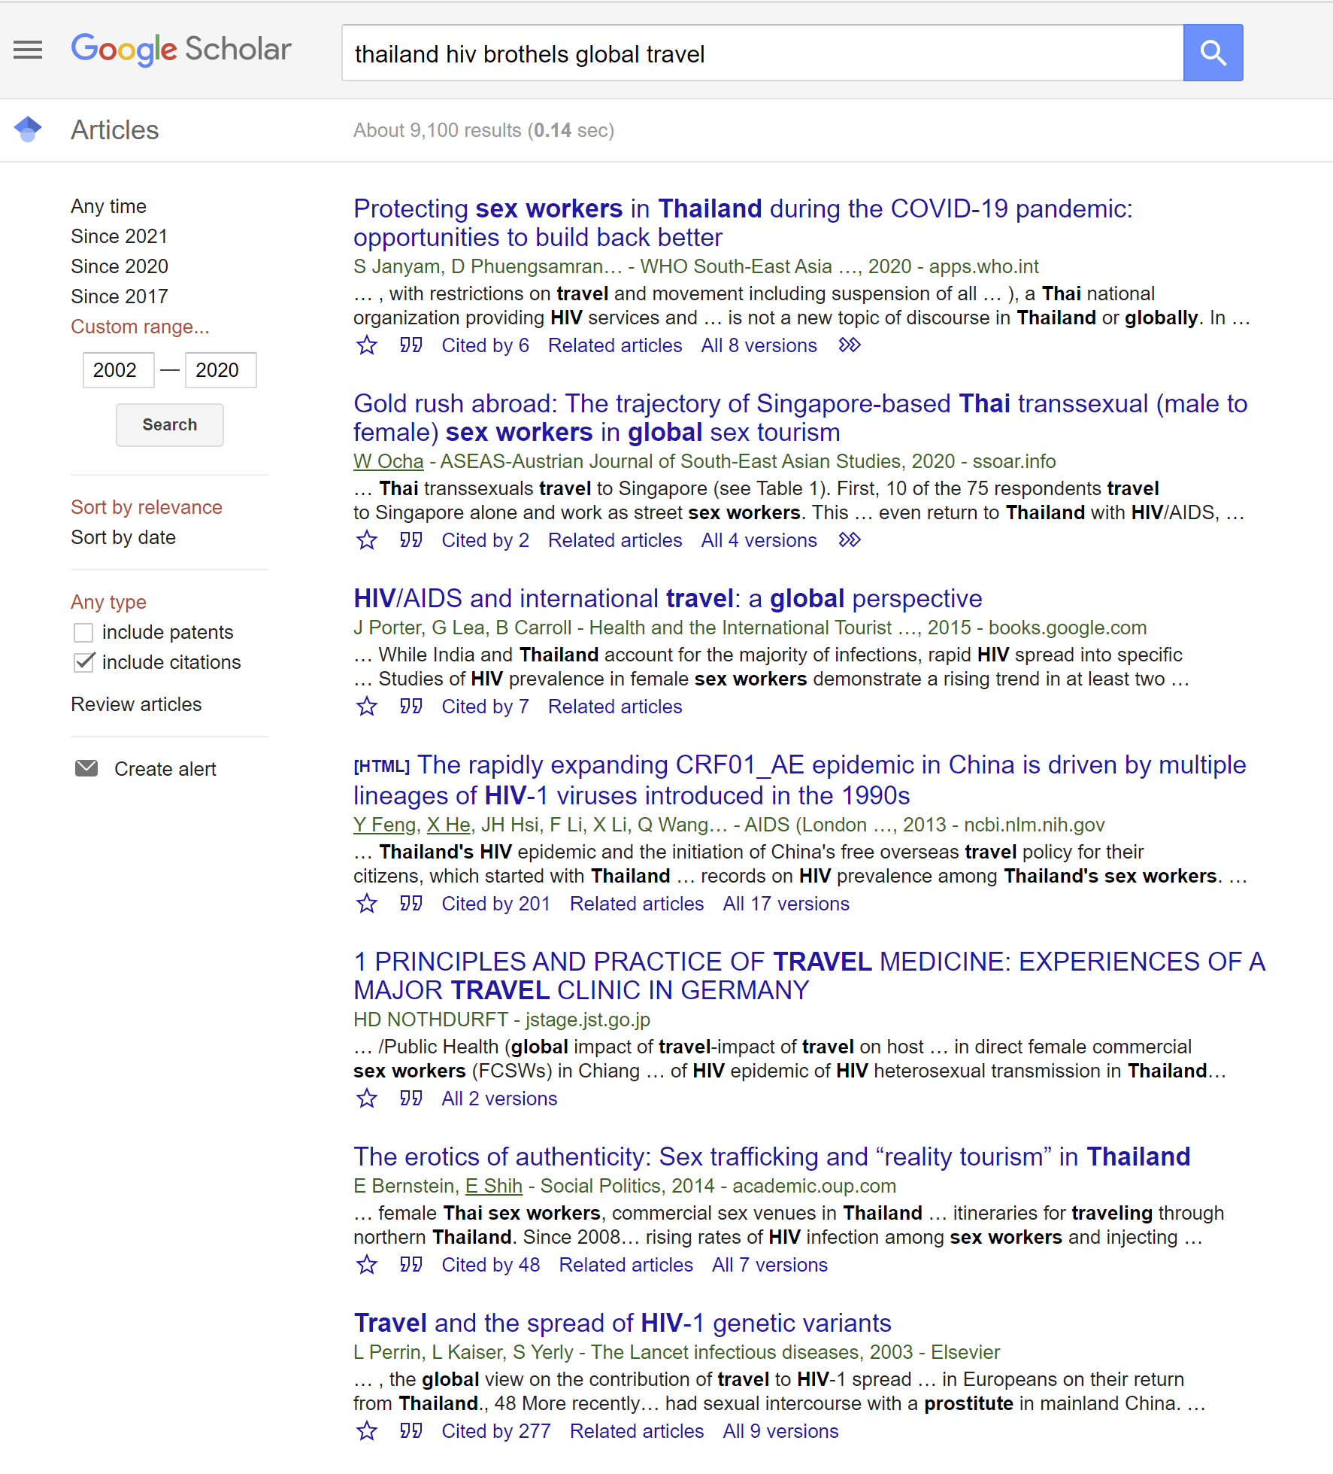

Slide 83

See you next week
We will discuss non-communicable diseases and global health
We will go through another example of creating the global context for your essays
Enjoy your weekend!

